Slide 1
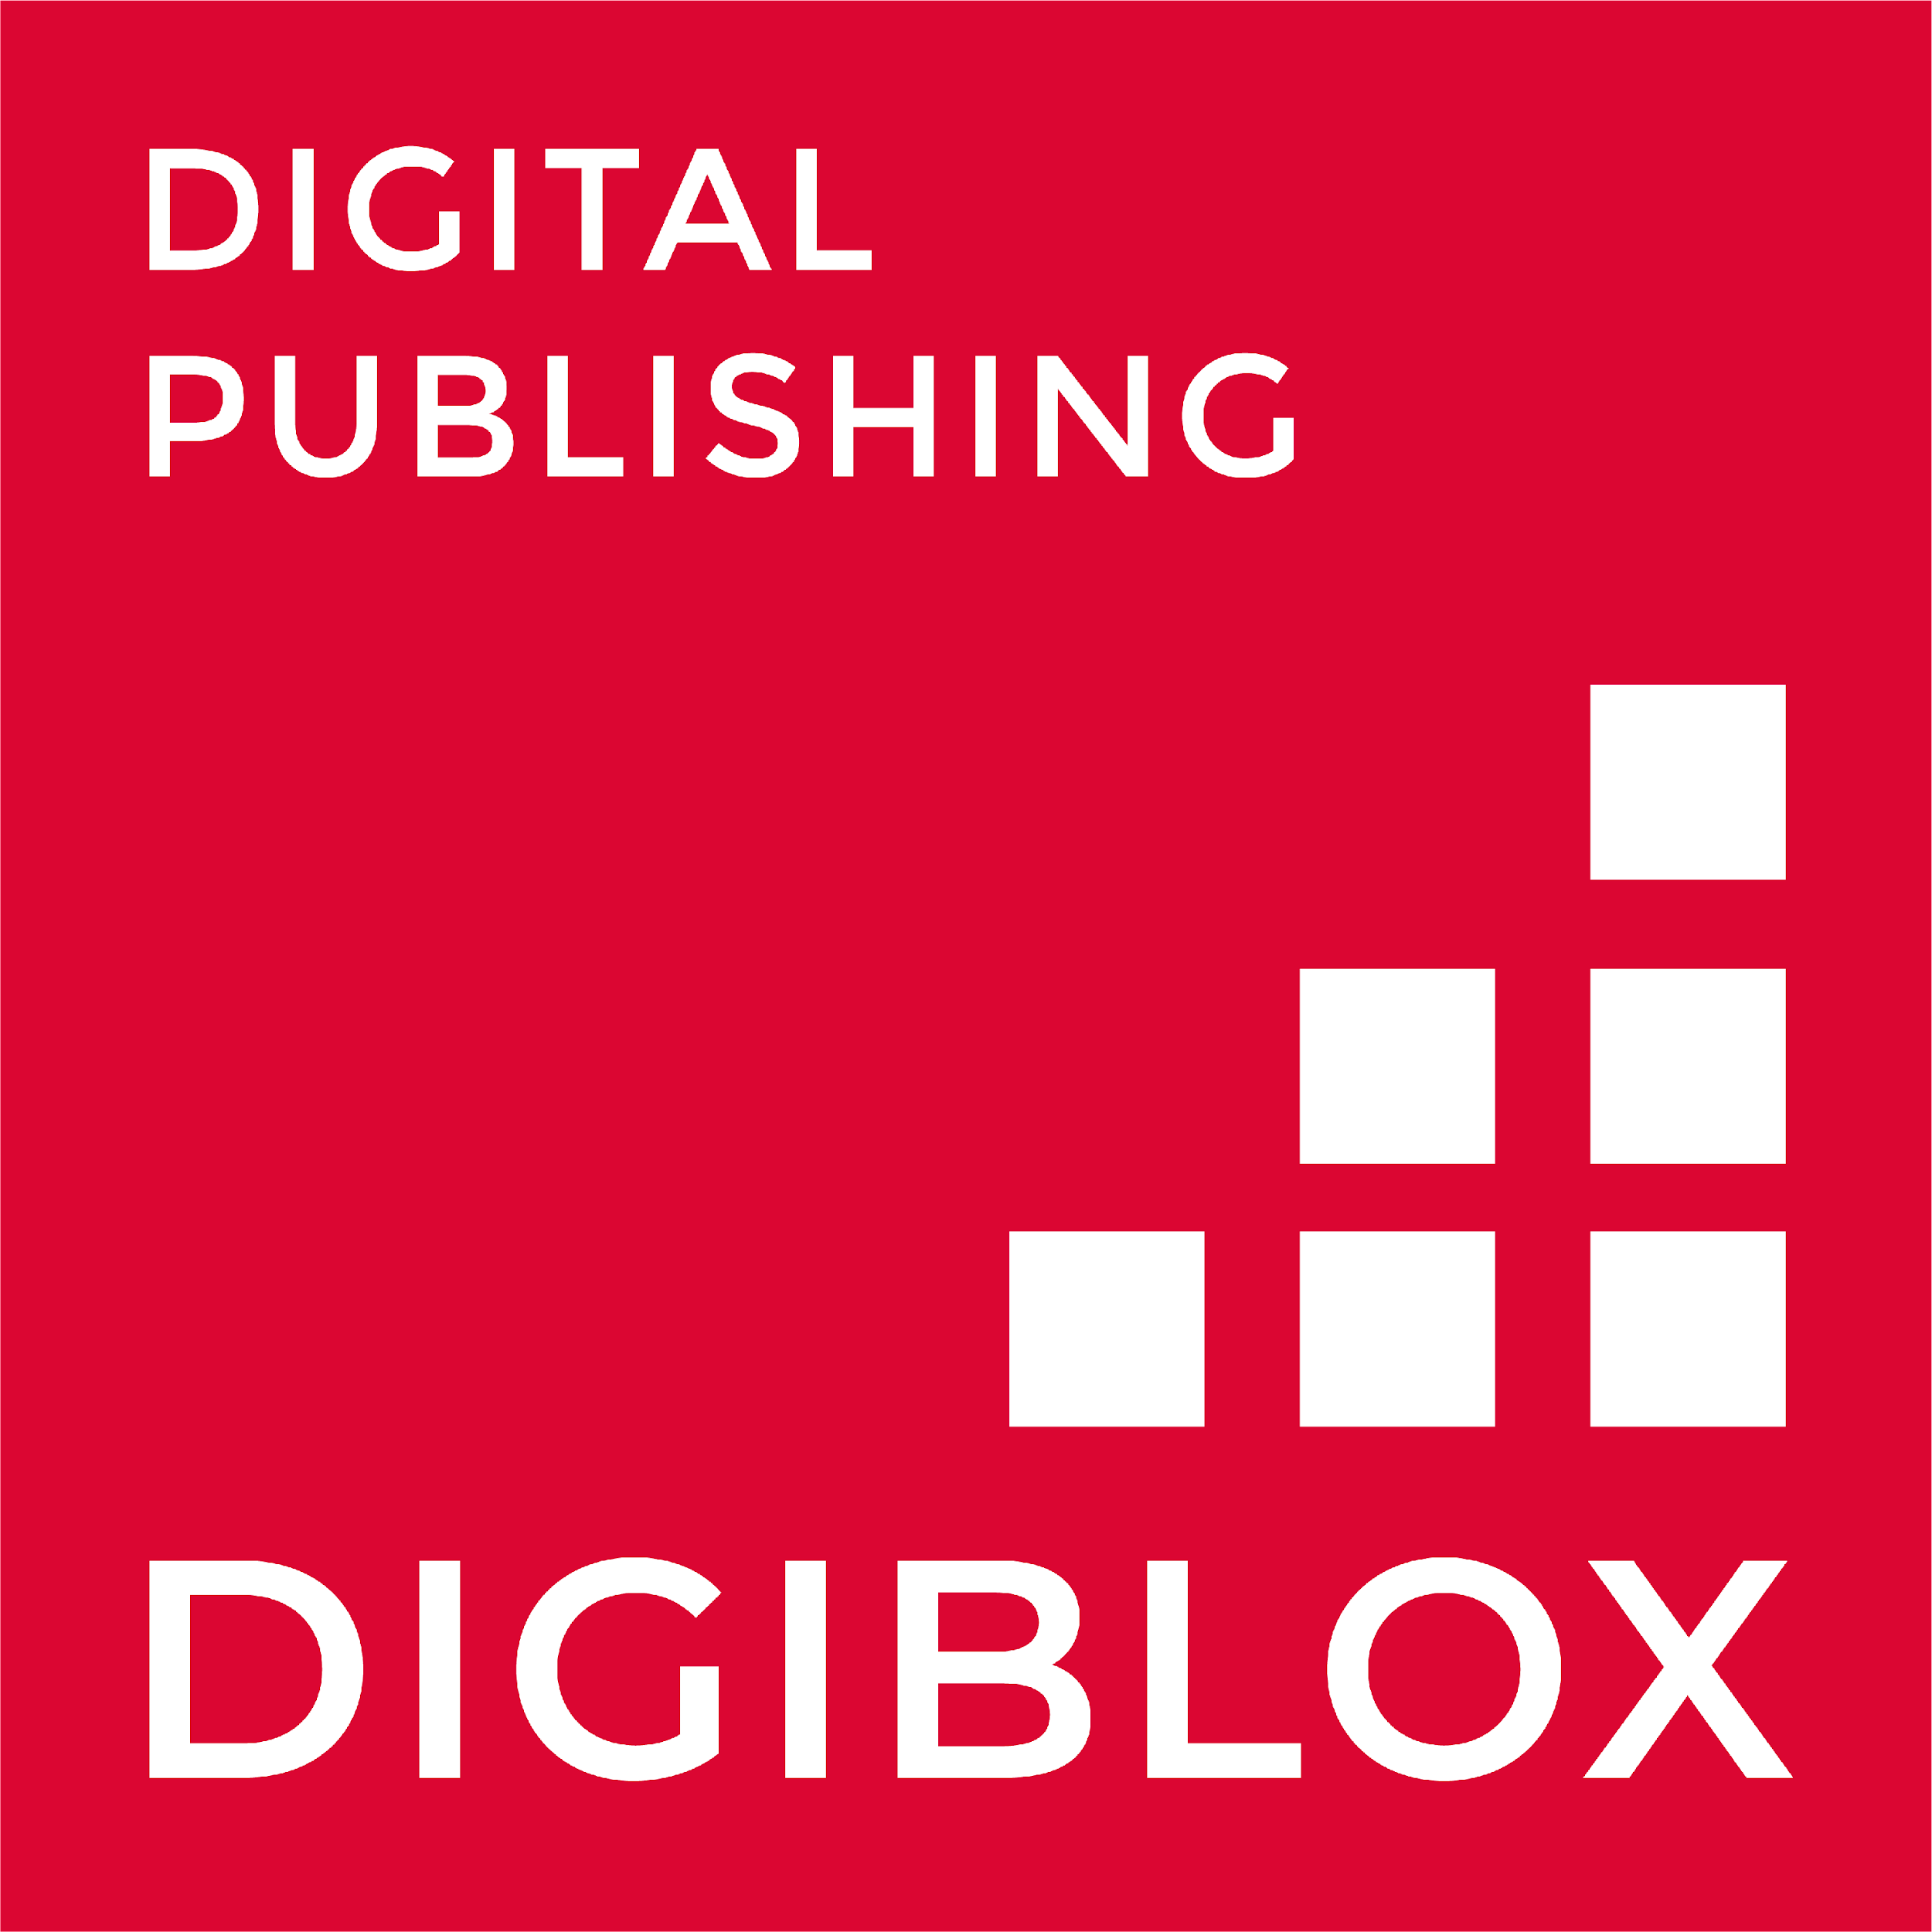
UNIT 3. ECVET DIGITAL PUBLISHING
UNIT 5 – MARKETING AND PUBLIC RELATIONS
What is Digital Marketing?

Slide 2
Contents
What is Digital Marketing
Main types of Digital Marketing
Benefits of Digital Marketing

Slide 3
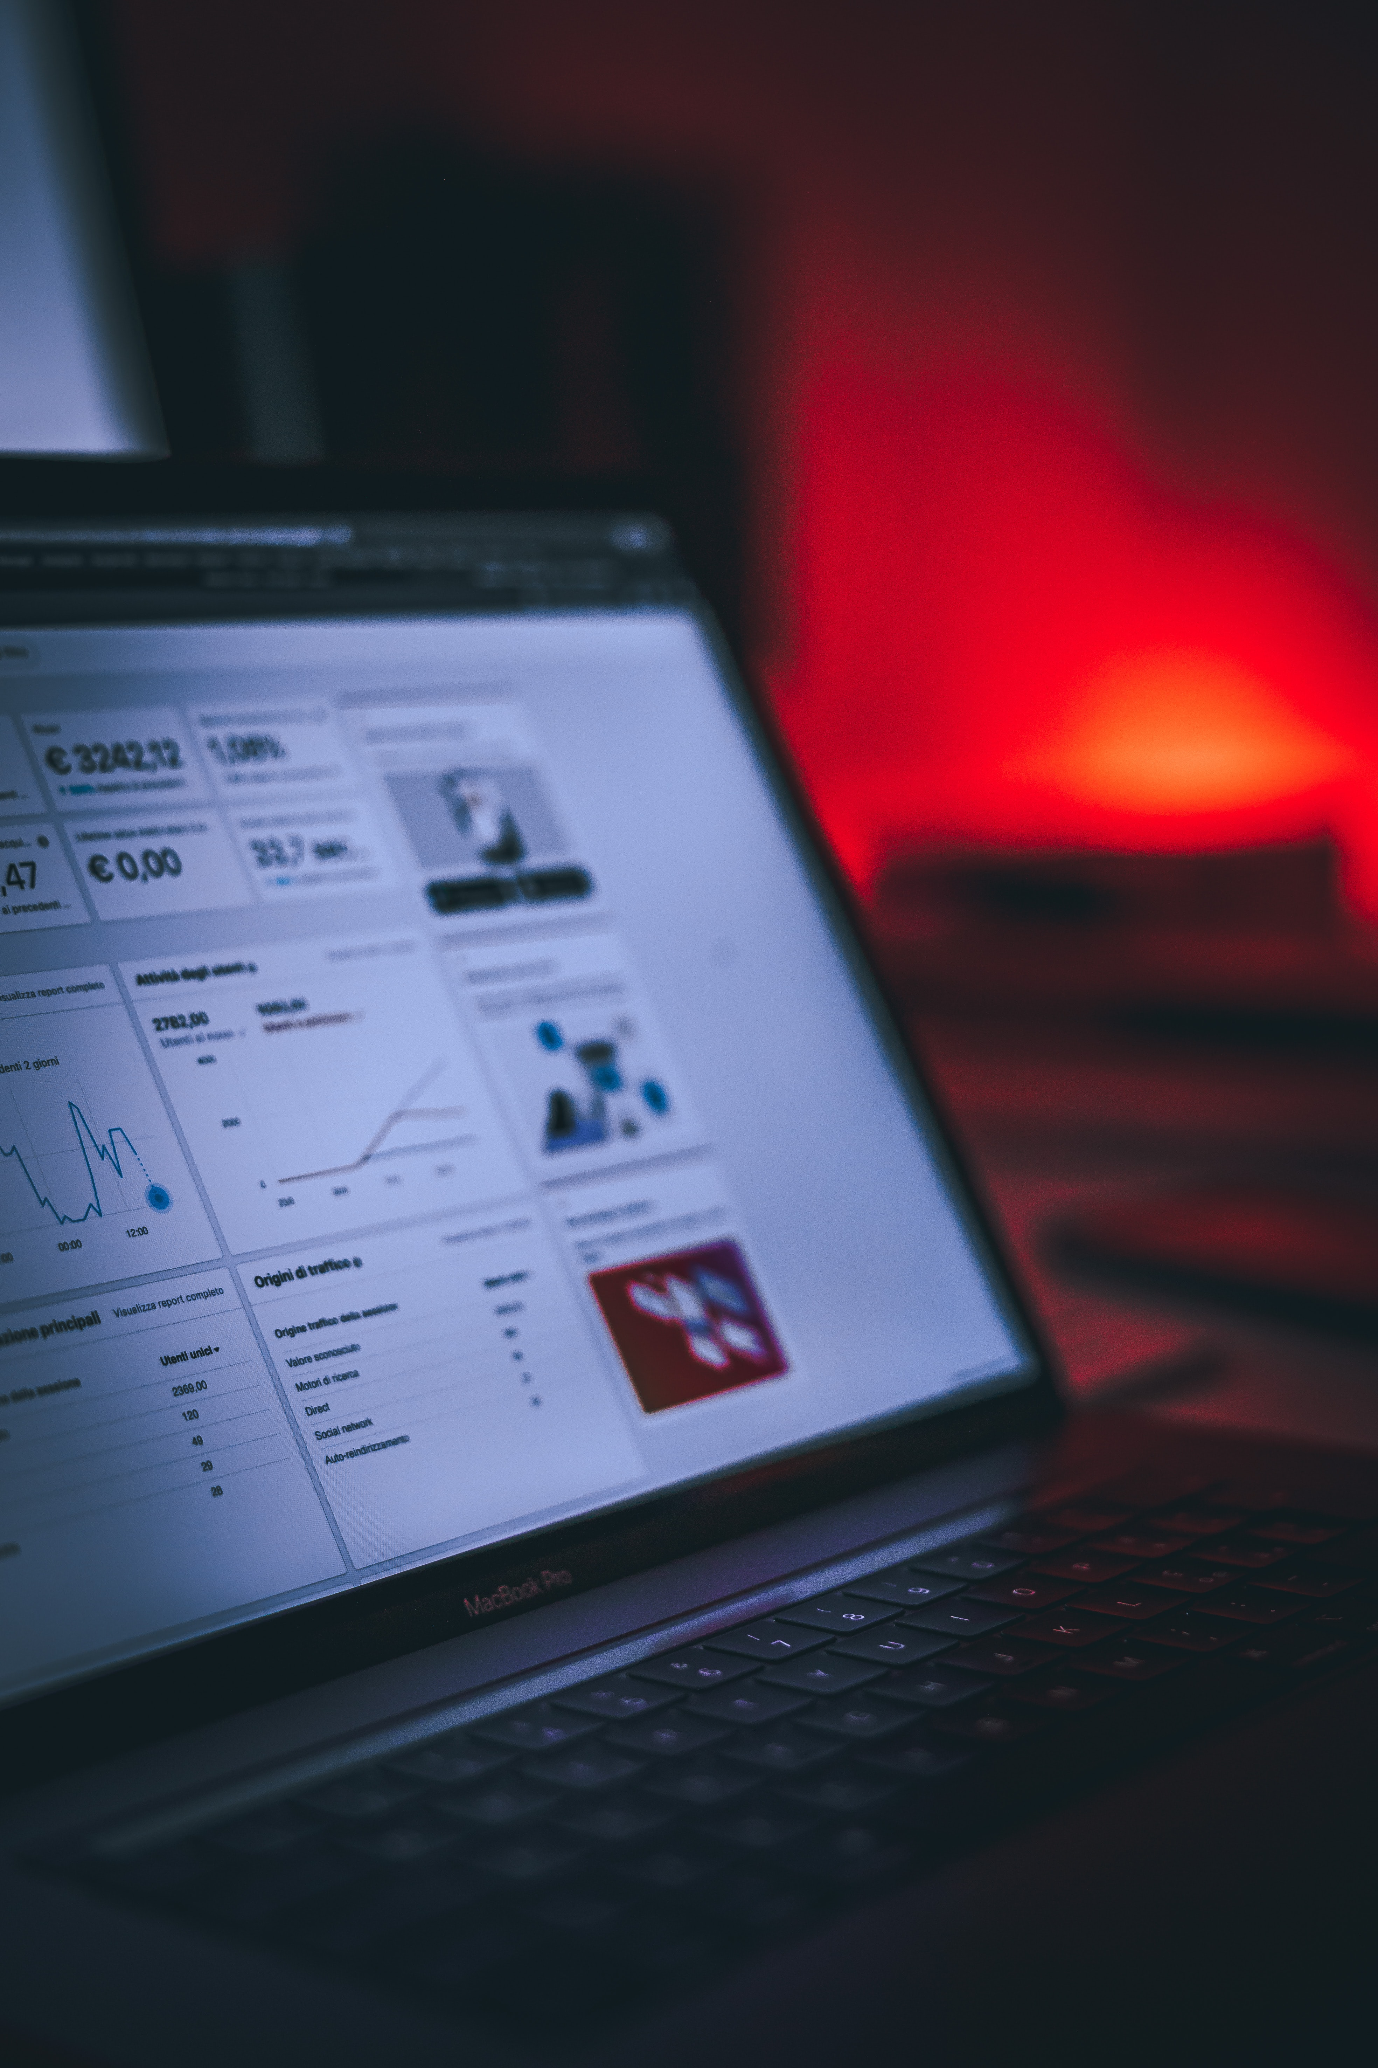
ECVET for Digital Publishing
MARKETING & PUBLIC RELATIONS
WHAT IS DIGITAL MARKETING?
Digital Marketing is essential for any business. Its main channels and its advantages will help you design the best strategies or trust an agency to carry out all the actions related to the online media.
Digital Marketing (or Online Marketing) is a set of marketing techniques that are carried out in Internet media and channels. It is about using online resources and opportunities to promote a business or brand efficiently.
In other words, Digital Marketing is a system for selling products and services to a specific target that uses the Internet through online channels and tools in a strategic and consistent way with the company's general Marketing strategy.
“It is important to understand how digital marketing is influencing the book publishing industry”
3

Slide 4
ECVET for Digital Publishing
MARKETING & DISTRIBUTION
DIGITAL MARKETING CHANNELS
Marketing was traditionally done through print (newspapers and magazines) and broadcast ads (TV and radio). These are channels that still exist today.
Digital marketing channels have evolved and continue to do so.
There exist yet traditional channels of course, but digital means are growing over them, so we have to keep in mind that some companies may use multiple channels in their efforts.
4

Slide 5
MAIN TYPES OF DIGITAL MARKETING CHANNELS
ECVET for Digital Publishing
MARKETING & DISTRIBUTION
01
Website Marketing
05
Affiliate Marketing
02
Email Marketing
06
Video Marketing
03
Content Marketing
07
SMS Marketing
04
Social Media Marketing
5

Slide 6
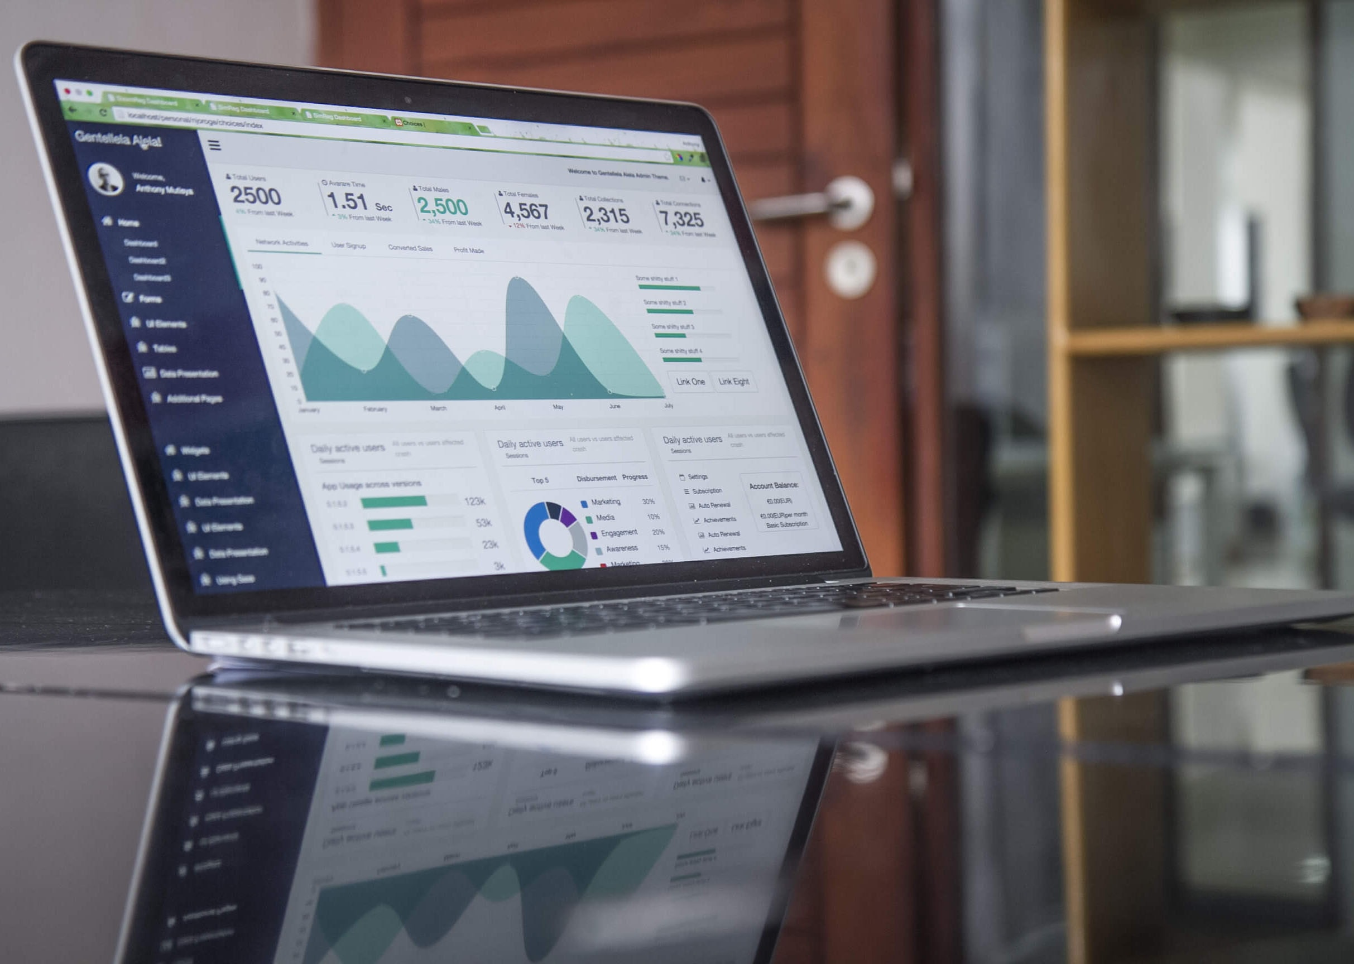
ECVET for Digital Publishing
01
MARKETING & DISTRIBUTION
WEBSITE MARKETING
Website marketing is the strategic promotion of a website to forward relevant traffic to the website. The aim is typically to attract people who may be interested in a company’s products or services. More traffic coming to a site means more opportunities to put your value proposition in front of potential customers.
An optimized website provides a branded customer experience that answers questions and demonstrates the unique value of your offerings. Every aspect of your brand’s online presence radiates out from your website.
6

Slide 7
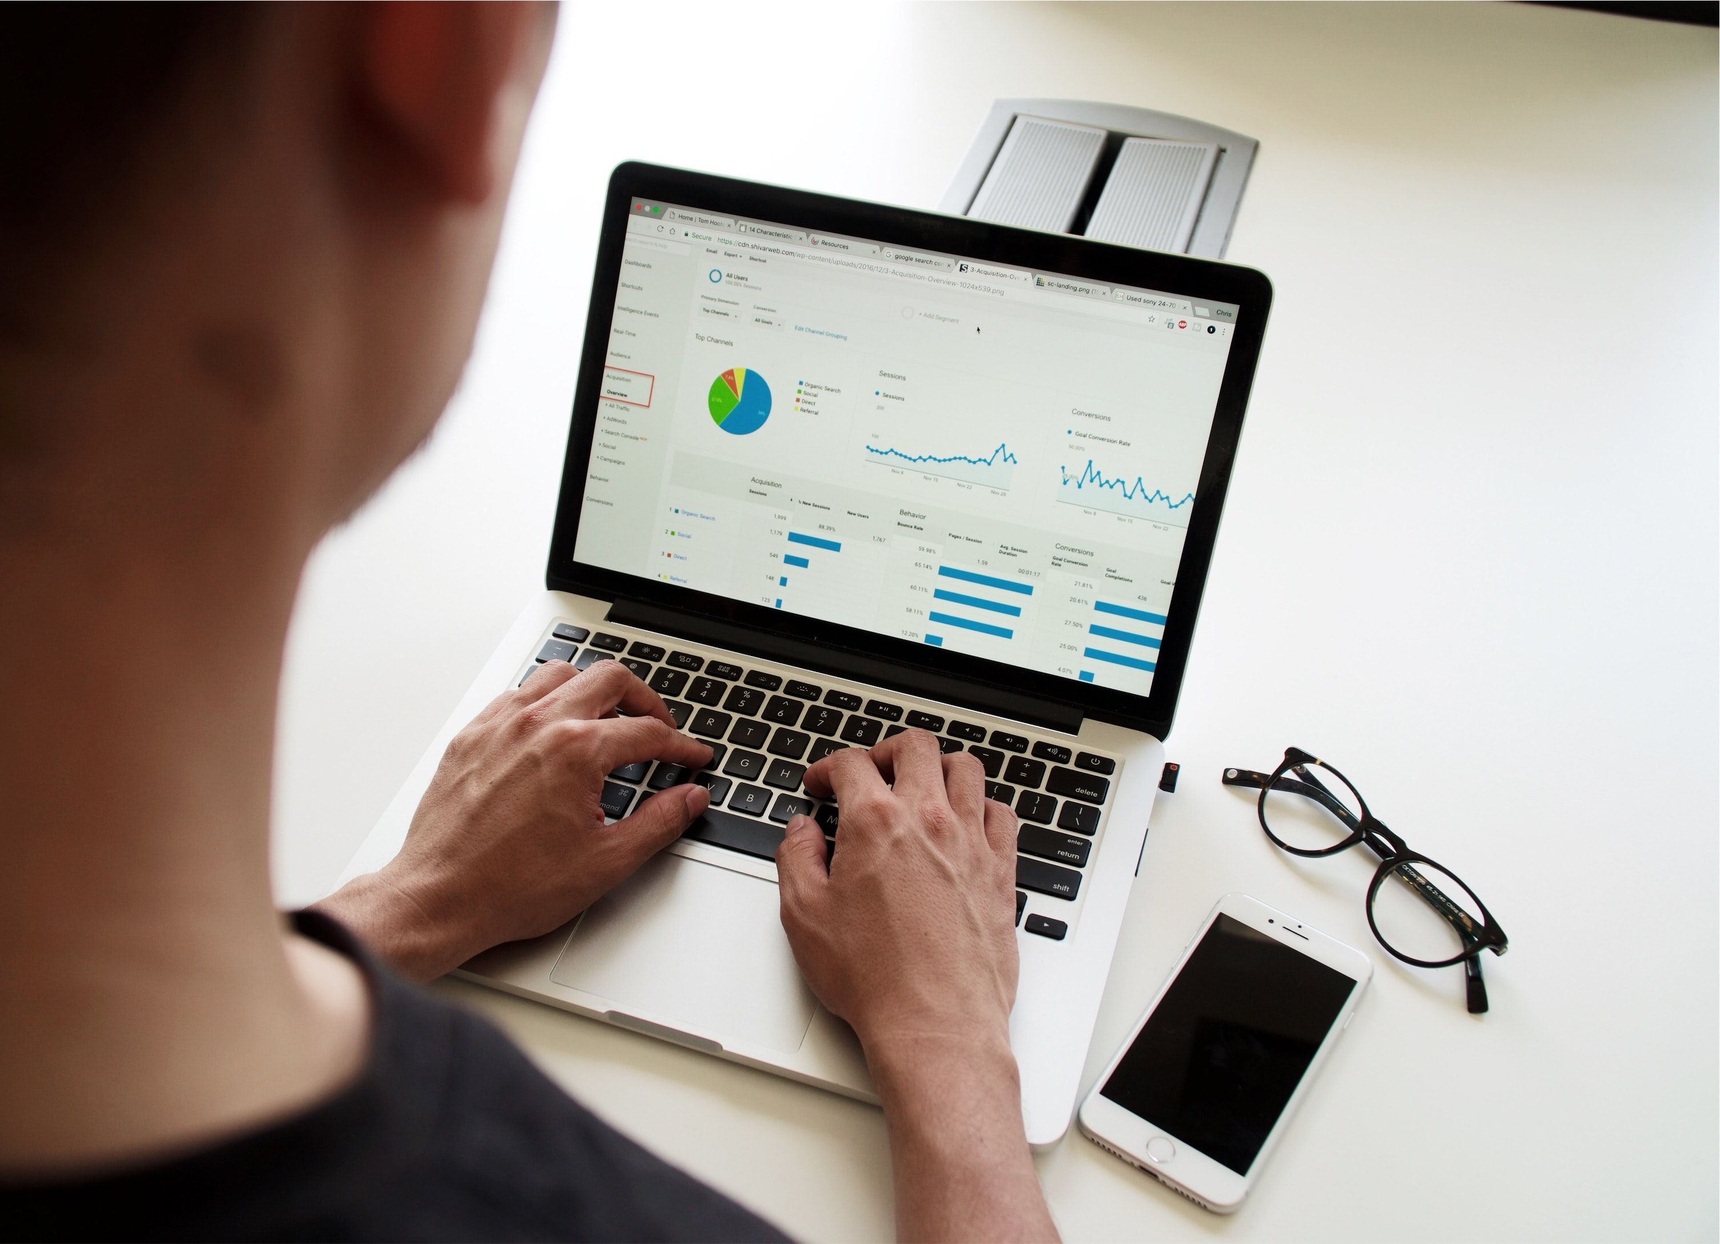
ECVET for Digital Publishing
MARKETING & DISTRIBUTION
SEM
SEM stands for search engine marketing
SEM is a digital marketing strategy used to increase a website visibility in search results. This can include both paid and organic (SEO) efforts.
But in colloquial terms, SEM is mostly referred to paid marketing.
PPC
PPC stands for pay per click.
It is a form of SEM, but in this case, you don’t pay for the ad on the search results page directly, as you would with a banner or display ad. Instead, you pay each time someone clicks on that ad to get to your website.
7

Slide 8
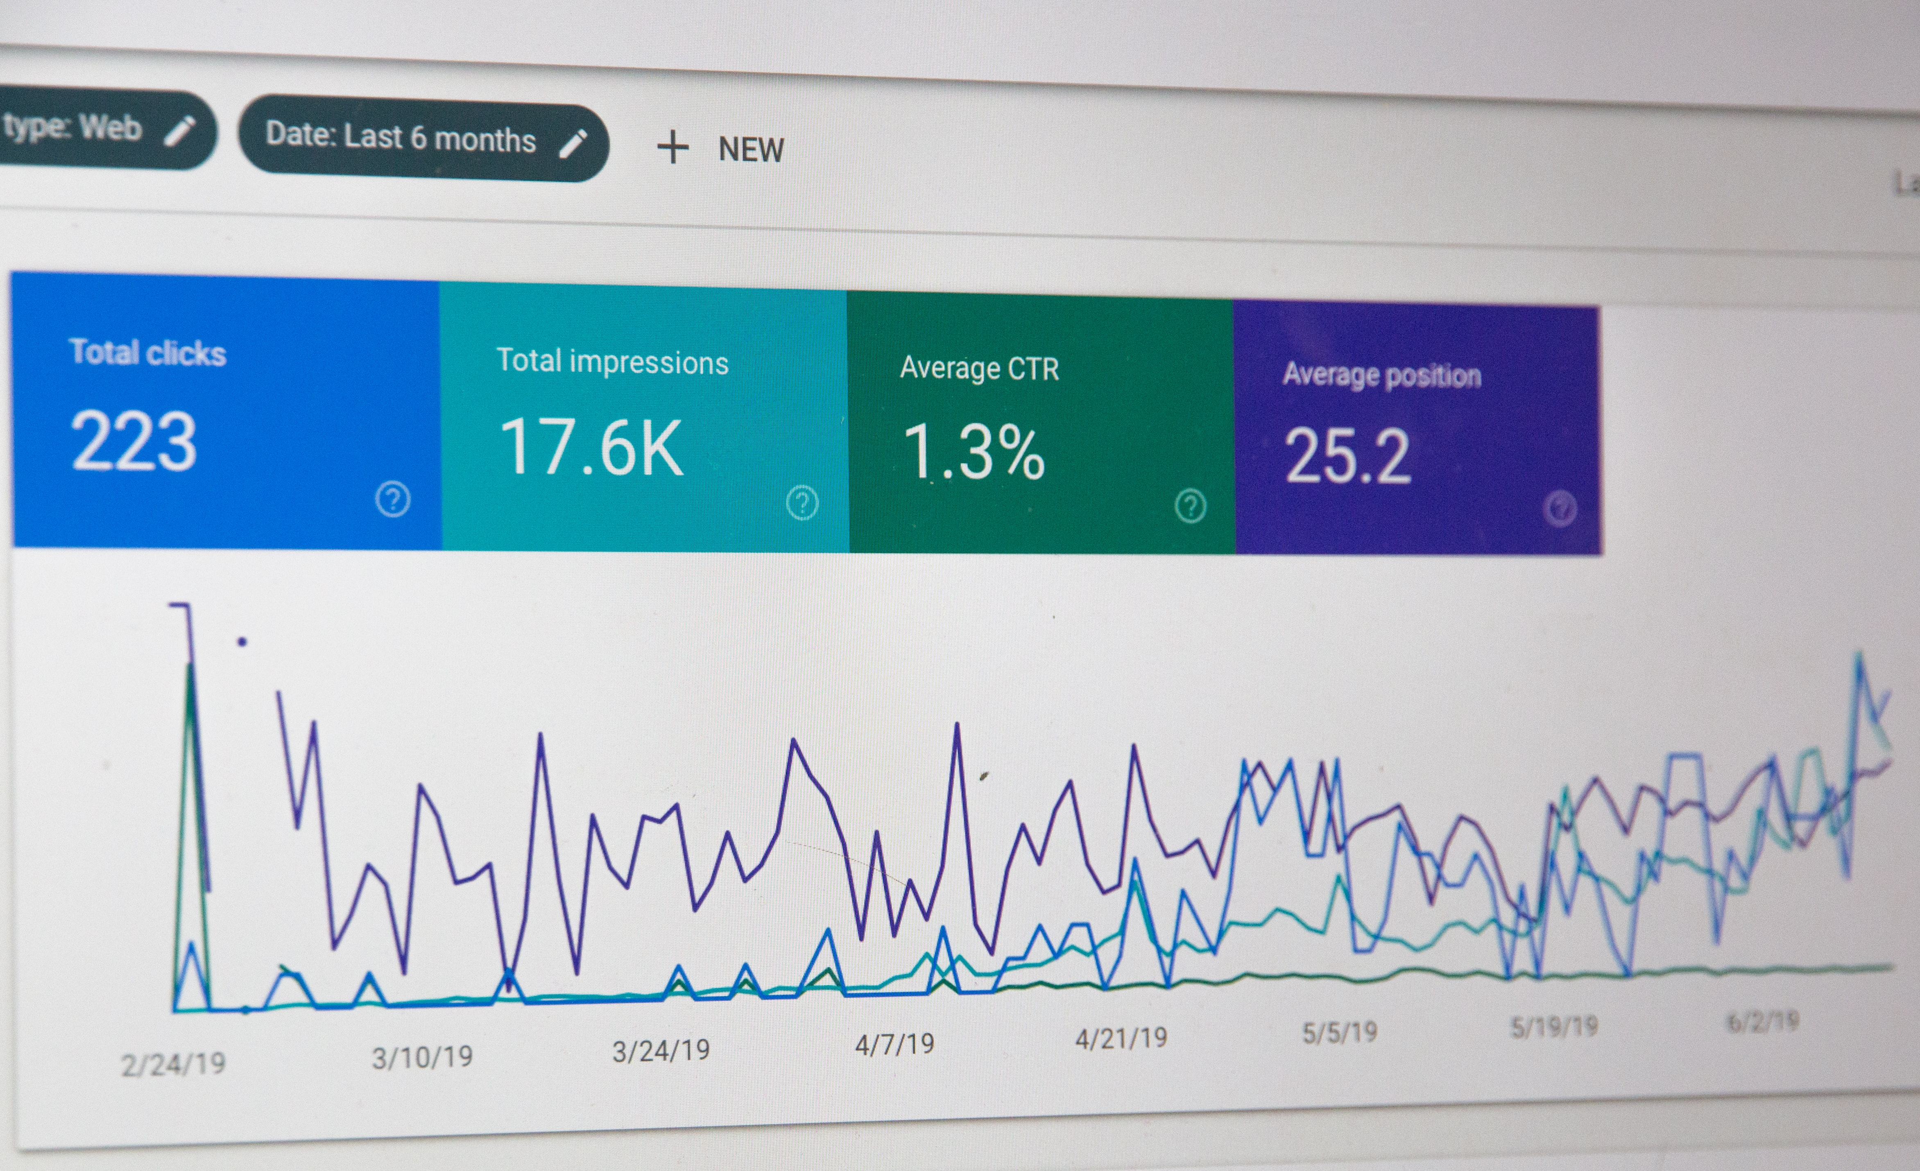
ECVET for Digital Publishing
MARKETING & PUBLIC RELATIONS
SEO
SEO stands for Search Engine Optimization
In simple terms, it means the process of improving your site to increase its visibility when people search for products or services related to your business in Google, Bing, Yahoo or any other other search engines.
A good SEO will provide you free” traffic as a result of providing relevant, useful content that ranks well on Google.
8

Slide 9
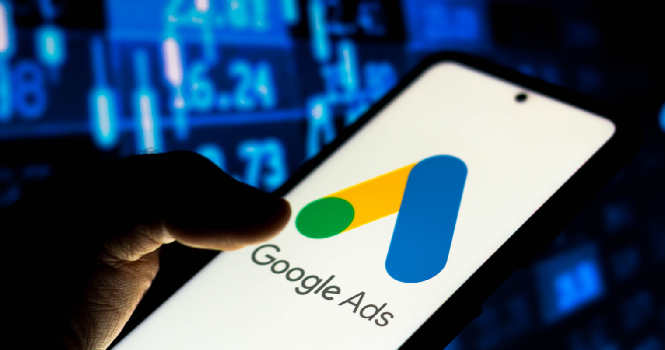
ECVET for Digital Publishing
MARKETING & DISTRIBUTION
Website Marketing
tools
Google Ads
The main tool used for creating online ads to reach people exactly when they're interested in the products and services that you offer.
9

Slide 11
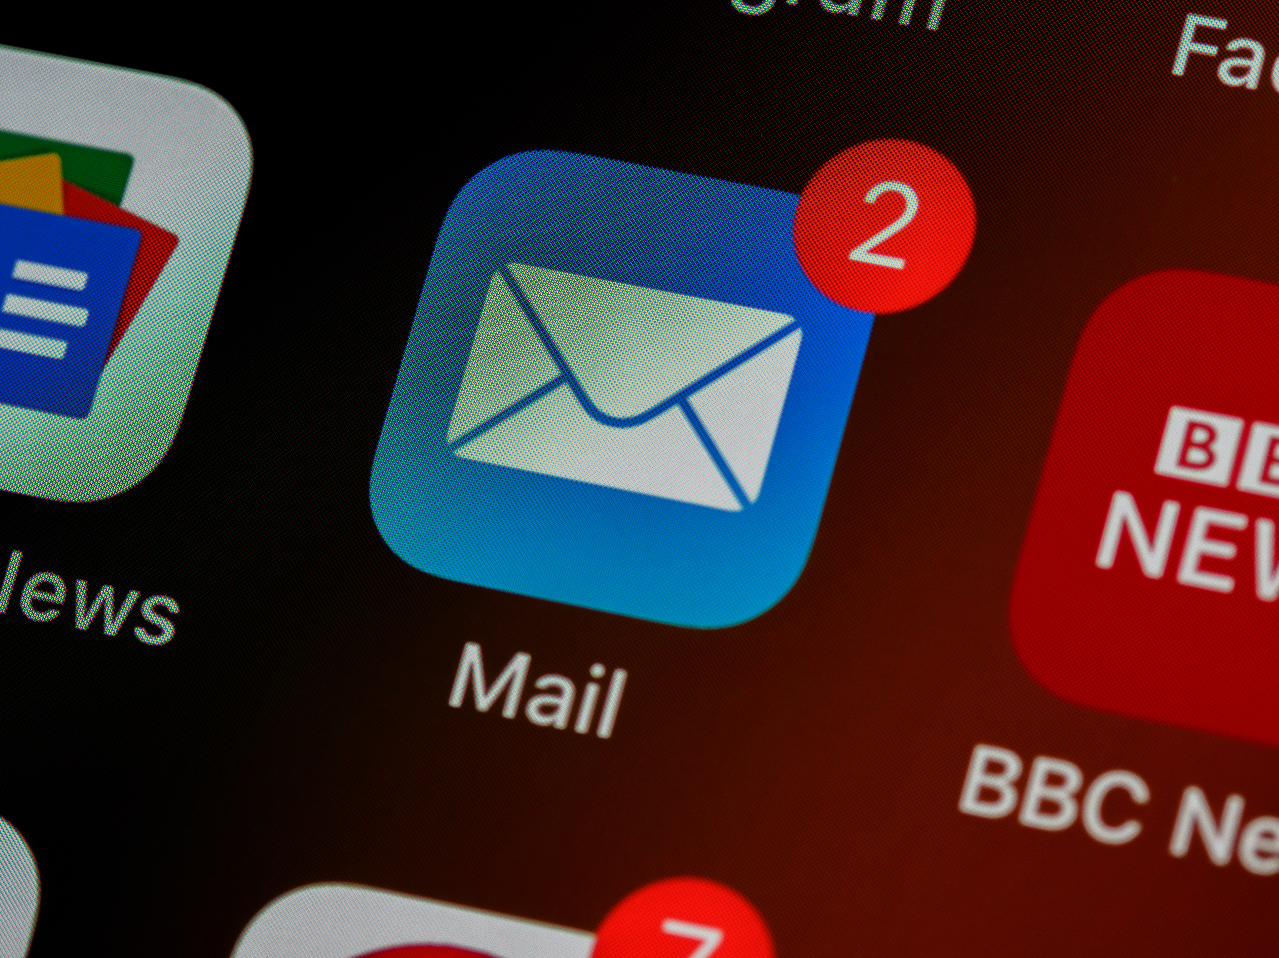
ECVET for Digital Publishing
02
MARKETING & DISTRIBUTION
EMAIL MARKETING
Email offers a much more personal manner of connecting with your target audience. It is a kind of internet marketing that can truly make your product different from the rest.
You can offer exclusive ‘insider’ content, special discounts, and customized content to your email subscribers to make them feel special.
The attractive offers may also get that your non-subscribers to sign up for next emails.
10

Slide 12
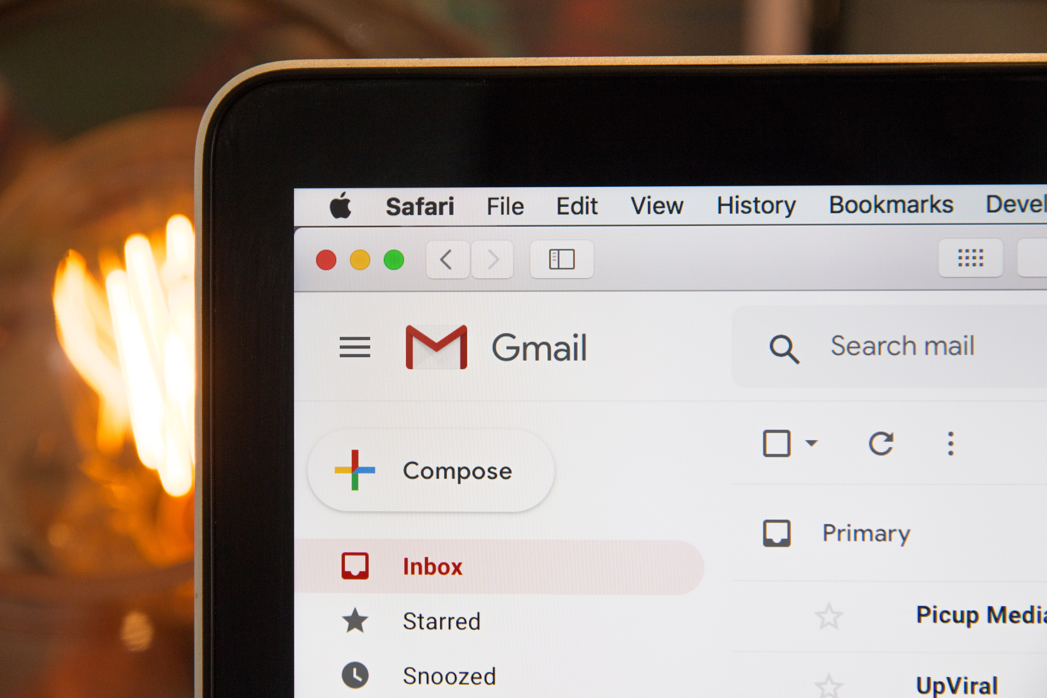
ECVET for Digital Publishing
MARKETING & DISTRIBUTION
Email Octopus
Email
Marketing
tools
Mail Chimp
ConvertKit
Moosend
GetResponse
MailJet
Easymailing
11

Slide 13
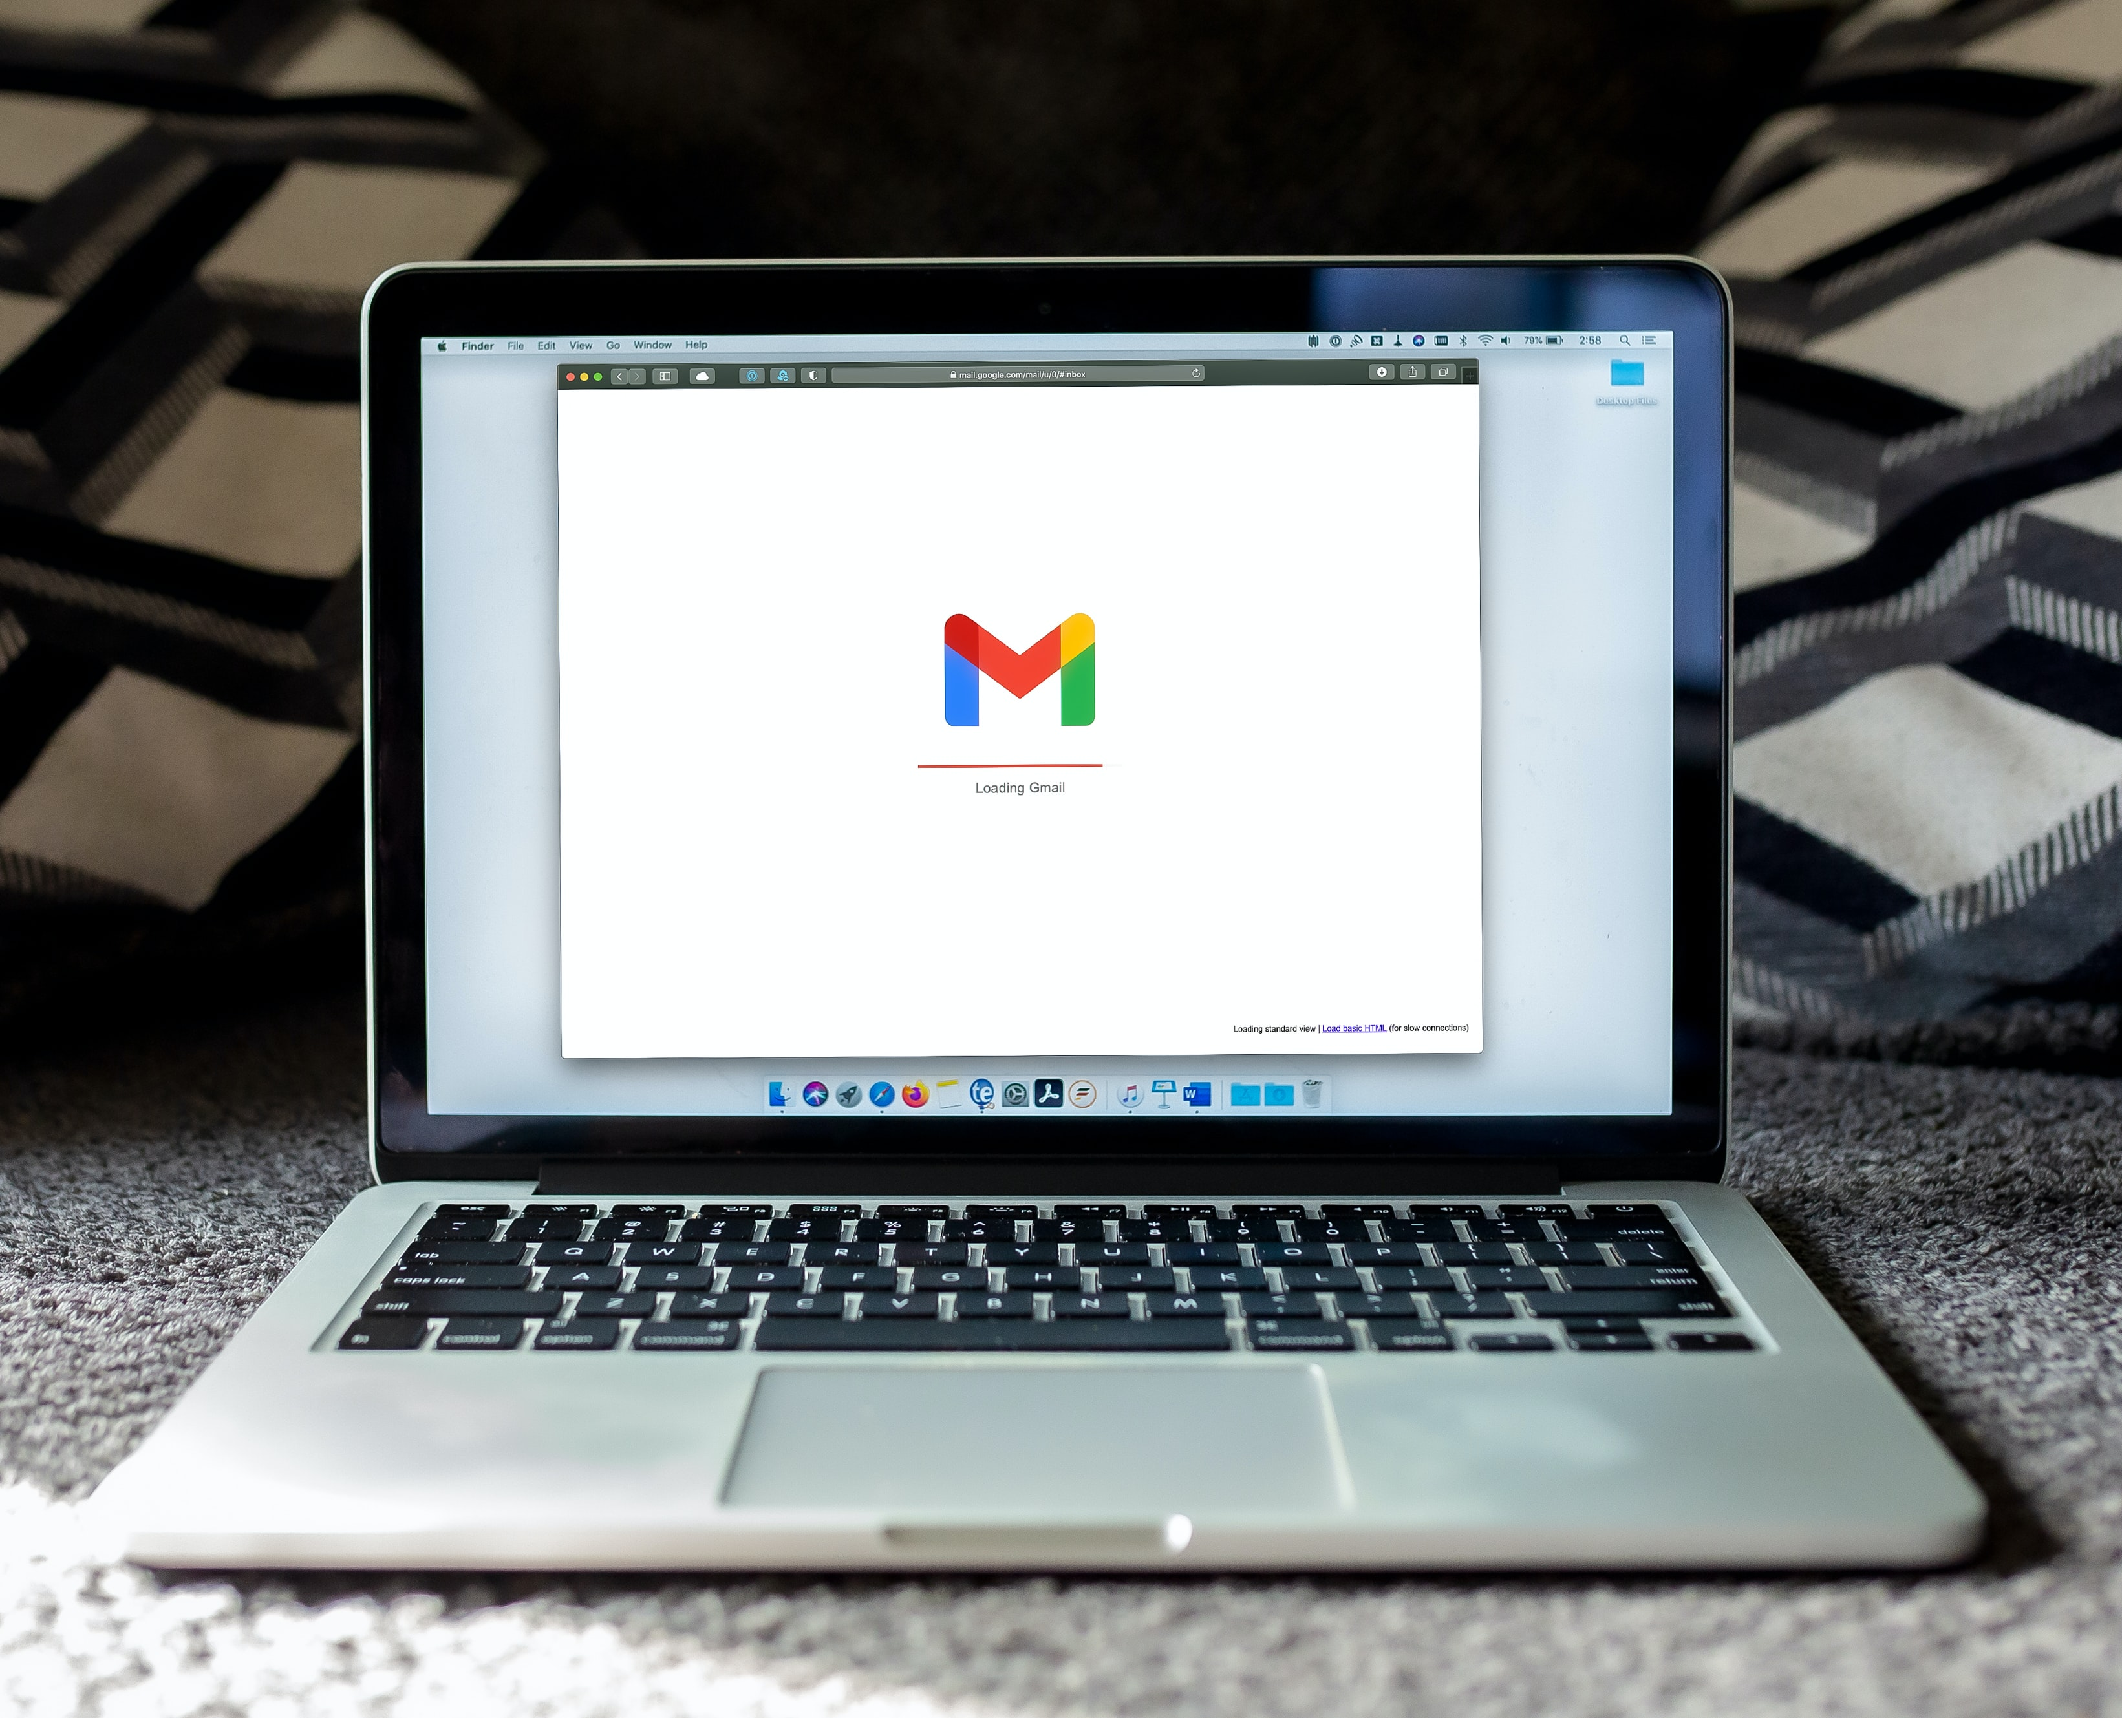

Slide 14
ECVET for Digital Publishing
03
MARKETING & DISTRIBUTION
CONTENT MARKETING
Content marketing is focused on attracting potential customers in a natural way, based on relevant content that is distributed in the different channels and digital media in which the audience is.
Thanks to this marketing technique you will be able to work the entire user purchase cycle. Since the person realizes that he or she has a need to buy something until he or she decides to buy it.
12

Slide 15
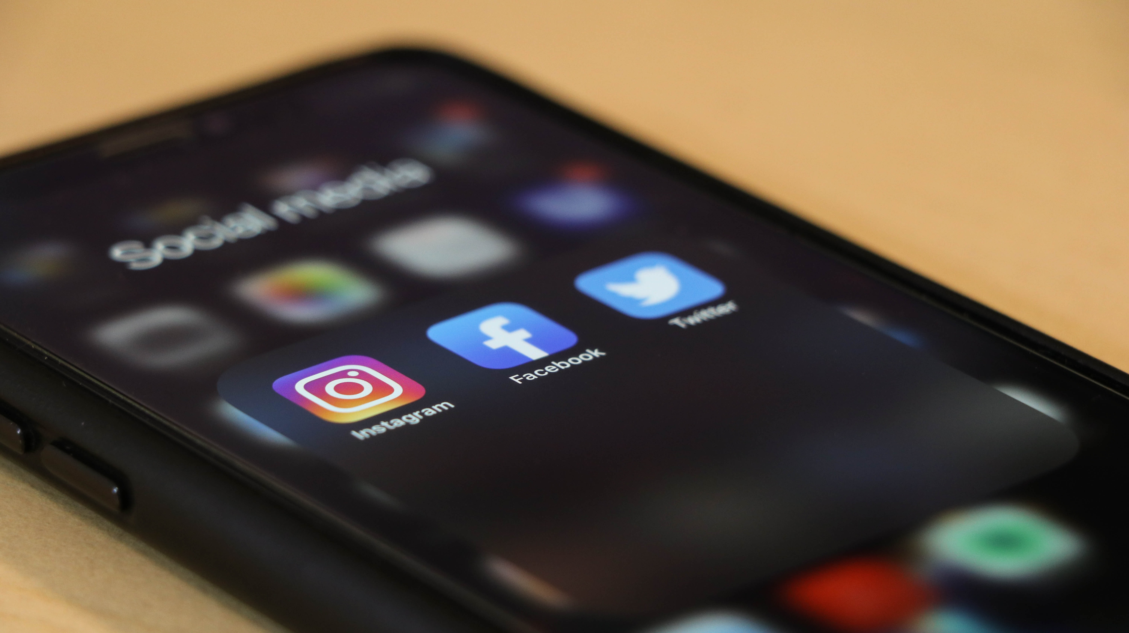
ECVET for Digital Publishing
04
MARKETING & DISTRIBUTION
SOCIAL MEDIA MARKETING
Social media is one of the most powerful internet marketing tools nowadays. Platforms like Facebook, Instagram, YouTube, Twitter, ….give the opportunity for a real communication between the two parts.
Users see promoted content based on their profile, interests, likes, and the content they share. It is a very useful way to promote a brand since everybody is now on Social Media.
13

Slide 16
ECVET for Digital Publishing
MARKETING & DISTRIBUTION
Social Media
Marketing
tools
Facebook Ads
Instagram Ads
Twitter Ads
Pinterest Ads
TikTok Ads
14

Slide 17
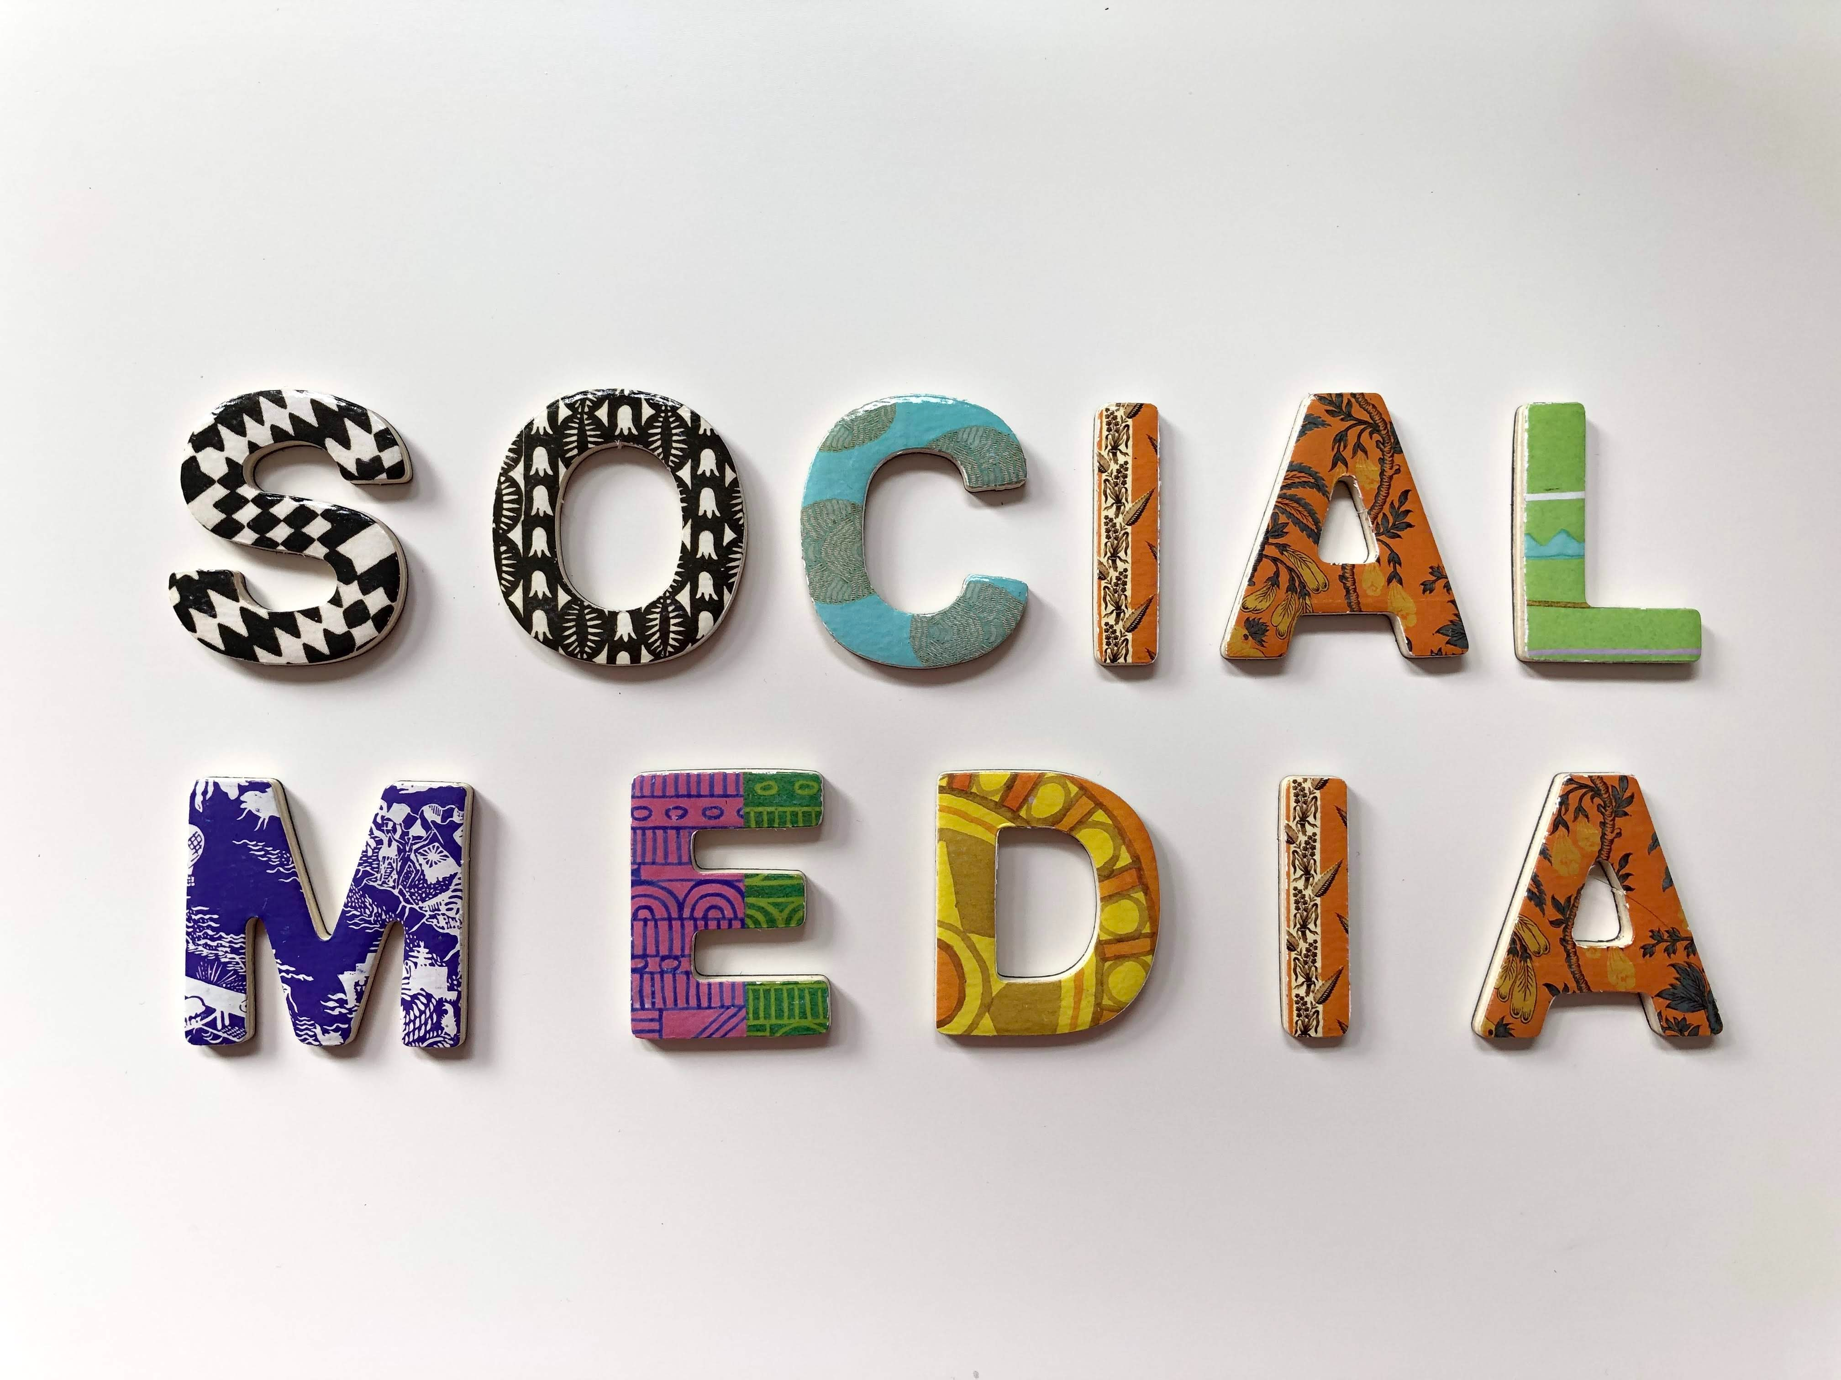

Slide 18
ECVET for Digital Publishing
05
MARKETING & DISTRIBUTION
AFFILIATE MARKETING
Online sellers can achieve that other sellers or certain people to sell their products and services.
Affiliate marketing is a process where the affiliate (person offering the link and talking about the product) earn a commission by promoting a product or service made by another retailer or advertiser using an affiliate link.
15

Slide 19
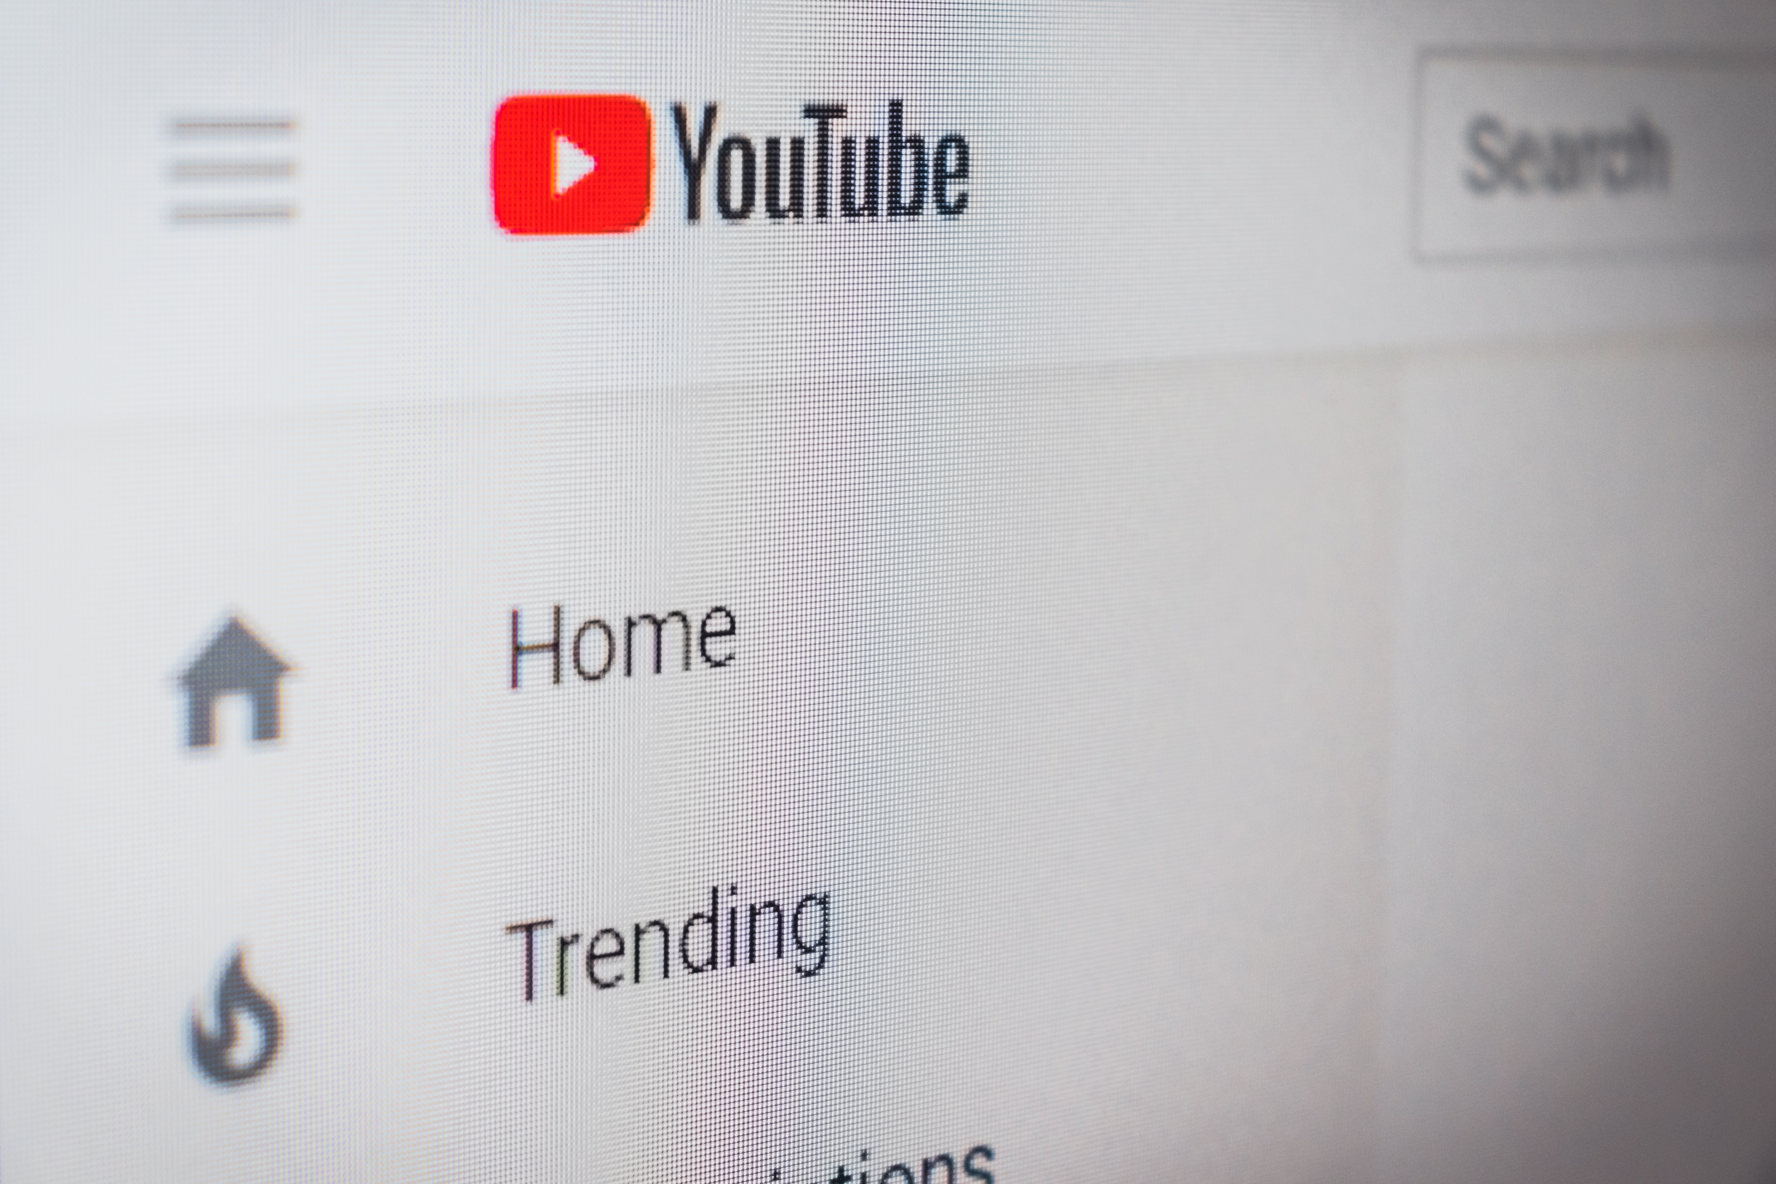
ECVET for Digital Publishing
06
MARKETING & DISTRIBUTION
VIDEO MARKETING
Video advertising is one of the most entertaining and interactive online marketing channels. It includes online display ads that have a video within them.
Such ads are also played before, during, or after a video stream. After watching the ad, the viewer usually sees a call to action to purchase that product or service or know more about it.
16

Slide 20
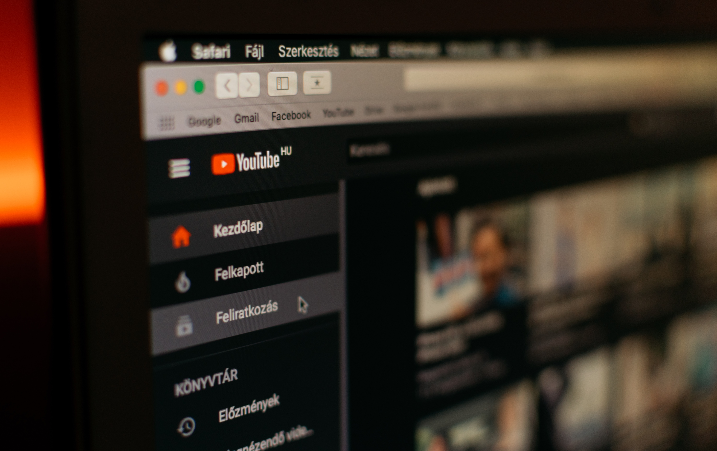
ECVET for Digital Publishing
MARKETING & PUBLIC RELATIONS
Video
Marketing
Tools
Youtube Ads
The main video platform now is Youtube.
The way of advertising could be your video playing before a user views another's video or showing up in YouTube search results for people to watch in full.
17

Slide 21
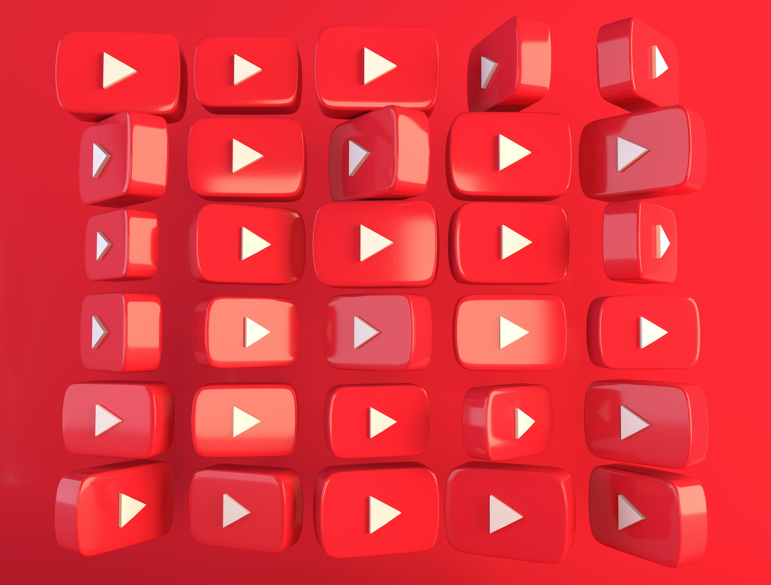

Slide 22
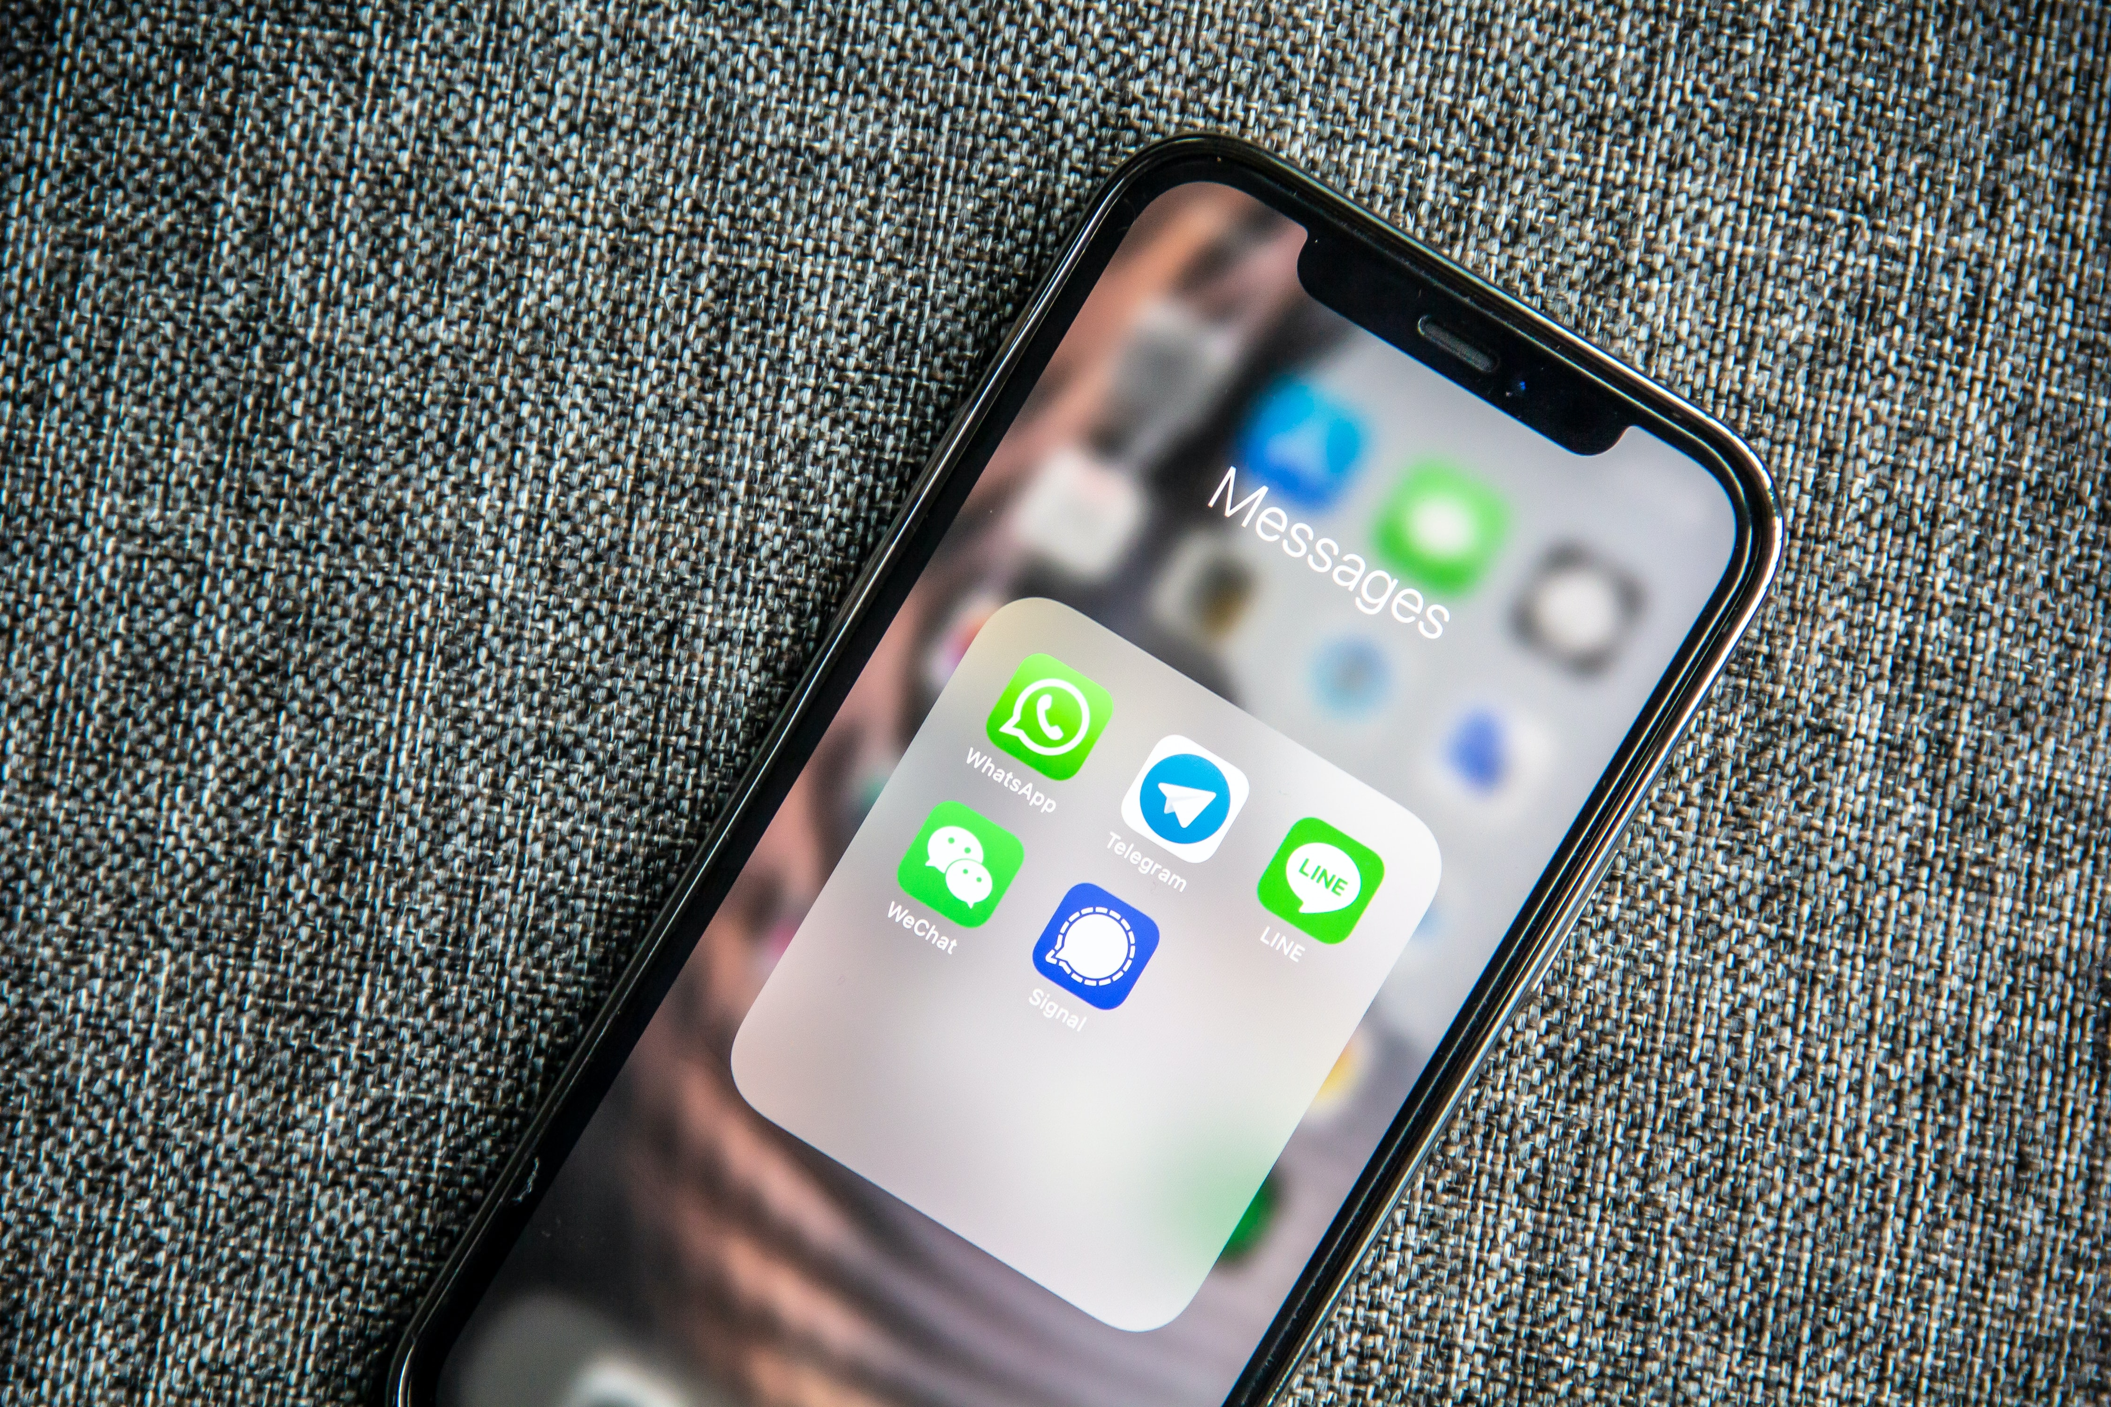
ECVET for Digital Publishing
07
MARKETING & DISTRIBUTION
SMS MARKETING
It consists on sending text messages to a list of subscribers who have registered their telephone number and granted their permission to receive SMS with commercial or transactional information.
SMS campaigns can be used for various purposes such as communicating news, offers and reminders or urgent alerts among many other options.
It is successful because SMS are opened 98% of the times and we are always with our smartphone.
18

Slide 24
BENEFITS OF DIGITAL MARKETING
ECVET for Digital Publishing
MARKETING & DISTRIBUTION
01
You will get know your audience
05
It is adaptable
02
It is not that expensive
06
It can be personalized depending on the channel
03
You can market to anyone
07
You can really measure it
04
You can market anywhere
6

Slide 25
DIGITAL MARKETING IN 5 MINUTES
Press play

Slide 26
THANK YOU

Slide 27
ECVET for Digital Publishing
Project participants:

