Slide 1
UNIT 3. ECVET DIGITAL PUBLISHING
UNIT 5 – MARKETING AND DISTRIBUTION
Digital Marketing in Digital Publishing

Slide 2
Contents
Digital marketing in Digital Publishing
Digital Marketing Strategy steps
Digital product: E-book
How marketing your e-book

Slide 3
ECVET for Digital Publishing
MARKETING & DISTRIBUTION
DIGITAL MARKETING IN DIGITAL PUBLISHING
It is obvious that Digital Marketing is the main type of Marketing now but even more when it comes to Digital Products.
Constantly, digital products such as E-books, online courses, apps, stock photos and much more are so sold, distributed and consumed.
This is why market your digital product in a correct way is so important. Digital products are different so physical ones because them are not tangible so it must be taken into account.
“E-commerce is growing exponentially and we have to adapt to it”
3

Slide 4
DIGITAL MARKETING STRATEGY CREATION
ECVET for Digital Publishing
MARKETING & DISTRIBUTION
01
Explore the landscape
05
Choose your channels and tactics
Study your competitors and your performance and analyse the results.
If you choose them wisely, they will give you the best results.
02
Set out your goals
06
Set indicators and benchmark
What do you want to achieve and how.
Analyse your performance will be key to improve.
03
Define your target audience
07
Pay attention to the detail
Select to whom are you aimed.
Take some time to be sure you are using the best practices.
04
Build your content strategy
08
Analyse and adjust
Base it on your goals and audience.
Analyse, change the things that are not working and try again.
4

Slide 5
ECVET for Digital Publishing
MARKETING & DISTRIBUTION
DIGITAL PRODUCT
E-BOOK
Book industry is full of different kind of books so that is why it is so important to have a correct digital marketing strategy to stand out from the crowd.
No matter if the publisher is a huge brand or a small independent one, digital marketing is KEY.
Producing digital content, handling the digital distribution and information about a book, and keeping track on the online sales are the main points.
5

Slide 6
HOW MARKETING YOUR
E- BOOK
6

Slide 7
ECVET for Digital Publishing
01
MARKETING & DISTRIBUTION
PRODUCT PREVIEW
Before they even launch, marketing your digital product is a good way to show your potential costumers a bit more about your product.
Unlike physical products, you can market digital product by teasing a part of it and convince them that is what they are really looking for.
7

Slide 8
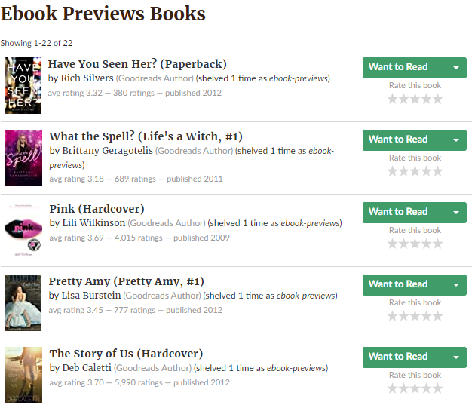
ECVET for Digital Publishing
MARKETING & DISTRIBUTION
Goodreads
Goodreads is a site for readers and book recommendations.
For example, in Goodreads you can have a preview of a huge list of e-books.
It allows you to read some pages before making the purchase.
8

Slide 10
ECVET for Digital Publishing
02
MARKETING & DISTRIBUTION
PRE-LAUNCH PROMOTIONS
You can show certain clues about what you will be launching.
With this, you are easily promoting your digital product and getting a sense of how much sales to expect from the interactions that prospective customers are doing with social media accounts and maybe your website.
9

Slide 11
ECVET for Digital Publishing
MARKETING & DISTRIBUTION
BOOK TRAILER
Like in the movies, you can create a book trailer that will give clues and short info about what is your book about but in a more visual and dynamic way.
Put it in social media and showing it in Youtube as a paid ad will be the most effective way
Everless by Sarah Holland
Book Trailer
10

Slide 13
ECVET for Digital Publishing
03
MARKETING & DISTRIBUTION
MAIL TO YOUR SUBSCRIBERS
Email marketing allows you to get a personal conversation with your subscribers. It is personal, cost-effective, and very effective regarding segmentation.
Promote your e-book by sending an email encouraging people to sign up for a copy.
You can set up emails when a person perform some action like download an excerpt of your book.
11

Slide 14
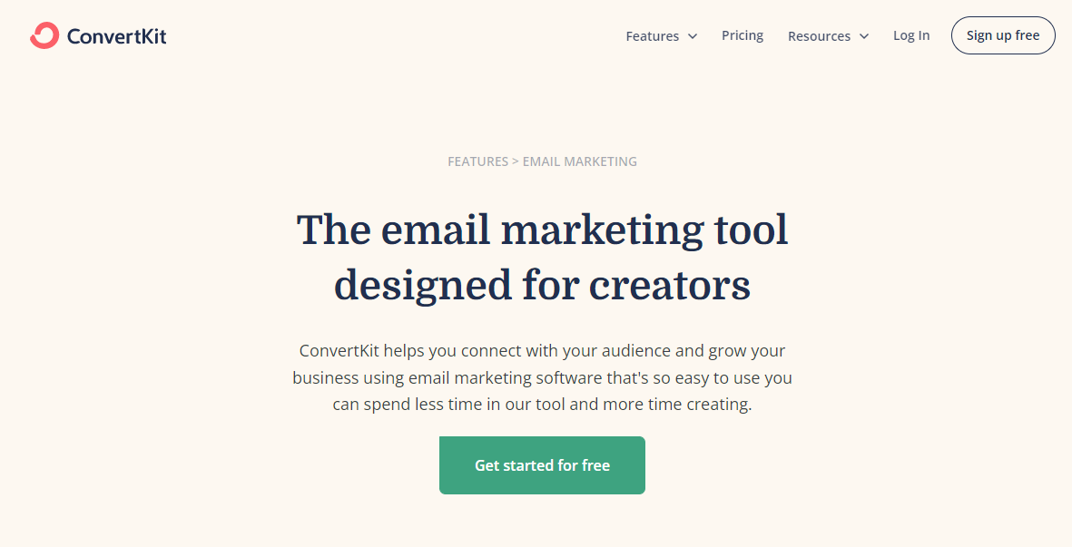
ECVET for Digital Publishing
MARKETING & DISTRIBUTION
CONVERTKIT
Convertkit is a tool that offers email marketing focused on creators.
Tips for your emails:
Pick a good subject
Personalise the emails (with names)
Add Call to action
Include rich media
Convertkit here
12

Slide 15
ECVET for Digital Publishing
04
MARKETING & DISTRIBUTION
USE THE POWER OF SOCIAL MEDIA
One of the best ways to promote an e-book is through social media.
Use a mix of social channels to promote your book to different audiences will be the most suitable.
But of course you have to adapt your strategy to make the best use of each channel depending on the kind of book you are promoting.
13

Slide 16
ECVET for Digital Publishing
MARKETING & DISTRIBUTION
Run contests and eBook giveaways
Social Media
Marketing
actions
Design banners for your e-book
Get into social media communities (FB groups, LinkedIn groups)
Run paid ads for greater reach.
Use quotations from famous authors to inspire and engage your readers.
Use campaigns to engage influencers
14

Slide 17
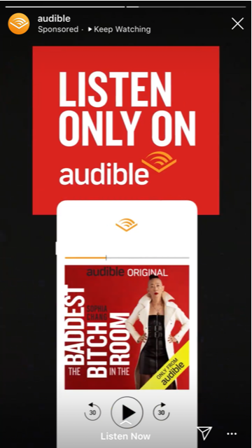
ECVET for Digital Publishing
MARKETING & DISTRIBUTION
Instagram Stories
Instagram stories are one of the examples of paid social media adds to promote your e-book.
In this example we can see audible, a platform for audio books.
Instagram stories are fast, direct and affordable.
15

Slide 19
ECVET for Digital Publishing
05
MARKETING & DISTRIBUTION
FREEBIES AND DISCOUNTS
Giving freebies and different discounts to your target audience when you are marketing your digital product can help you to get more sales.
This promotion can be different deals when it is about a digital product may come as bonus chapters, extended content, extra details…
16

Slide 20
ECVET for Digital Publishing
MARKETING & DISTRIBUTION
Gift with purchase
In this example, with a specific amount of purchase in the online store, you will get an e-book for free.
Each day, the mini e-book will be different to encourage customers to get them all in a certain period of time.
17

Slide 22
ECVET for Digital Publishing
07
MARKETING & DISTRIBUTION
REVIEWS AND TESTIMONIALS
Every product benefits from great reviews. Reviews have the power to influence consumer’s decisions and can strengthen the credibility of any product.
Even if your book is maybe what your customer is looking for, it will be more likely to get it if someone is recommending it on google, amazon or social media.
18

Slide 23
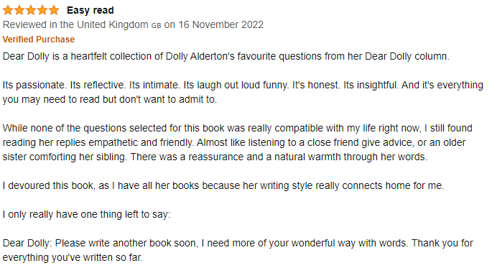
ECVET for Digital Publishing
MARKETING & DISTRIBUTION
Real opinions
Any customer looking for a book in general or maybe an specific one, will read the opinions of people with similar interests.
Try to ask your customers for an honest review of your products and ask for permission to share their reviews online to get more views and sales.
19

Slide 25
INSIDE PUBLISHING: BOOK MARKETING
Press play

Slide 26
THANK YOU

Slide 27
ECVET for Digital Publishing
Project participants:

