Slide 1
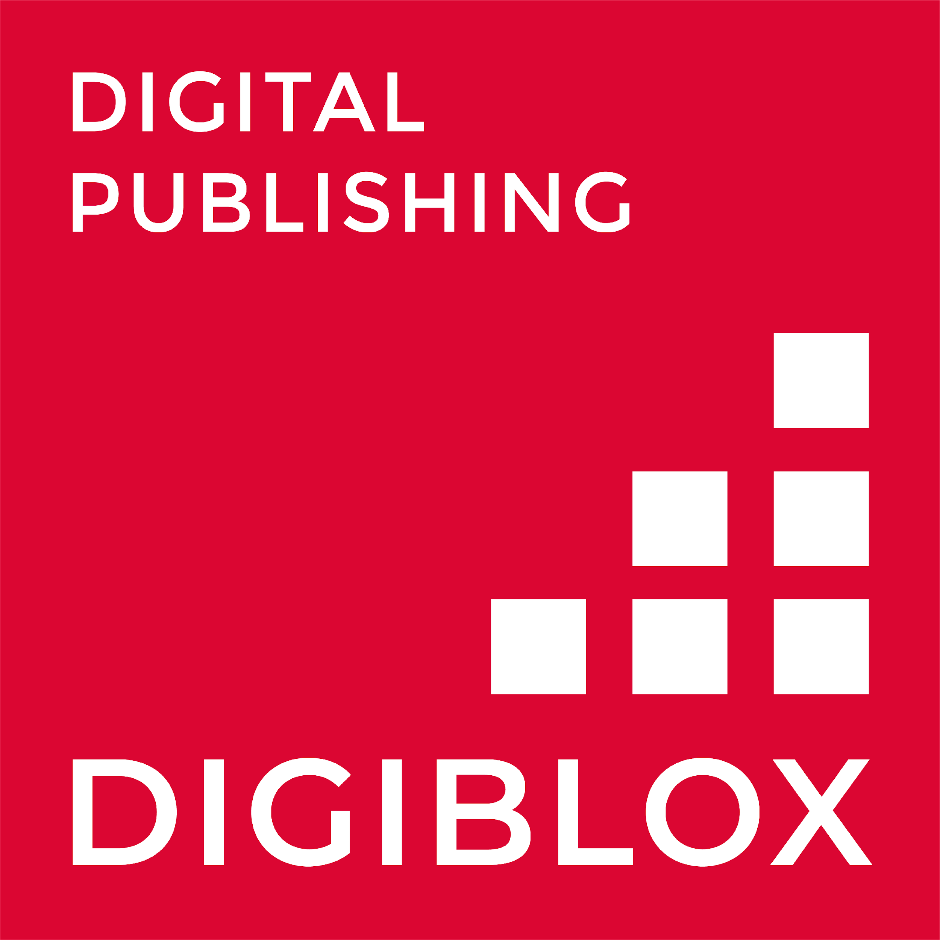
UNIT 3. ECVET DIGITAL PUBLISHING
UNIT 5 – MARKETING AND DISTRIBUTION
Public Relations

Slide 2
Contents
Public relations in Digital Publishing
Difference between PR and Digital Marketing
Public relations strategy
Types of Public Relations
Benefits of Public Relations

Slide 3
ECVET for Digital Publishing
MARKETING & DISTRIBUTION
“Digital PR is the professional maintenance of a positive online image”
PUBLIC RELATIONS IN DIGITAL PUBLISHING
Public relations tries to manage information between an individual or an organization and the public.
The aim of public relations is maintaining relationships with the public, and also managing the contact between different parties.
The goal of public relations is shapping how people think about a company, product, service, or person.
3

Slide 4
ECVET for Digital Publishing
MARKETING & DISTRIBUTION
DIFFERENCE BETWEEN PR AND DIGITAL MARKETING
Public Relations and Digital Marketing are closely related and sometimes can overlap but they are NOT the same thing.
The end goal is different. Marketing is focused on promoting a product to generate leads, Public relations try to maintain a good public image, improve relationships with clients and public in general and managing any crisis may arise.
4

Slide 5
PUBLIC RELATIONS STRATEGY CREATION
ECVET for Digital Publishing
MARKETING & DISTRIBUTION
Get to know your audience with personas
01
05
Create the content
By analysing where your customer is and why, you will have more success.
Base it on your goals and audience.
02
Create the right content based on your insights
Keep building your credibility and brand awareness
06
Base it depending on your goals and results.
Having a good image is key.
03
Find your brand’s voice
07
Measure your success
It is one of the most important parts of your strategy.
Check the things were really a good choice in your strategy.
04
Organize the editorial content calendar
08
Analyse and adjust
As in DM, it is key yo analyse and change things are not working.
Have a good organization will make you things easier
5

Slide 6
PR ACTIONS FOR YOUR
E- BOOK
6

Slide 7
ECVET for Digital Publishing
01
MARKETING & DISTRIBUTION
ONLINE EVENTS
Any kind of event is a great way to boost your marketing and PR efforts and maintain a effective relationship between your company and the media.
They are very good to create awareness about your book among people already know you and new people, too. Streaming via YouTube, Twitch or Instagram are great platforms to talk to your audience.
7

Slide 8
ECVET for Digital Publishing
MARKETING & DISTRIBUTION
Booktubers
Booktubers now use Youtube as a platform to talk about books.
They talk about books they like and also their own books. They upload prepared videos about book thematic but also schedule online events to talk to their audience about their new releases.
They also act sometimes as influencers recommending books from certain authors or editorials.
8

Slide 10
ECVET for Digital Publishing
02
MARKETING & DISTRIBUTION
BLOGGING
Blogging is where PR and content marketing meet.
Blogging is a very popular way to reach your audience and interact with the people through comments, also promoting these blogs on your social media accounts depending on who your audience is.
You can also collaborate with other bloggers to spread your content.
9

Slide 11
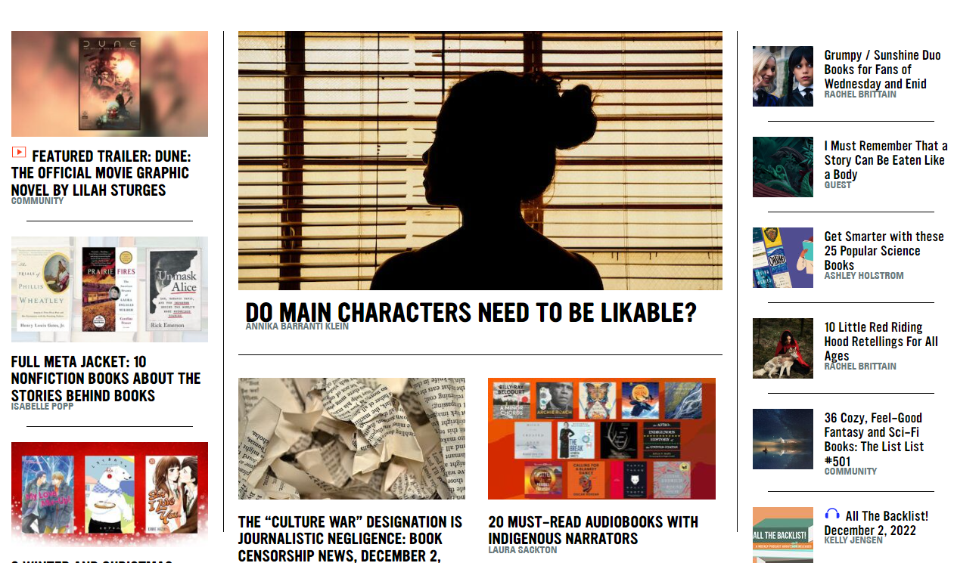
ECVET for Digital Publishing
MARKETING & DISTRIBUTION
BLOG
Book Riot is a blog about books with a very good editorial content.
It includes many different kind of information about all types of literature and books.
It includes newsletters, podcast that can be very useful for your PR strategy.
Book Riot Blog
10

Slide 13
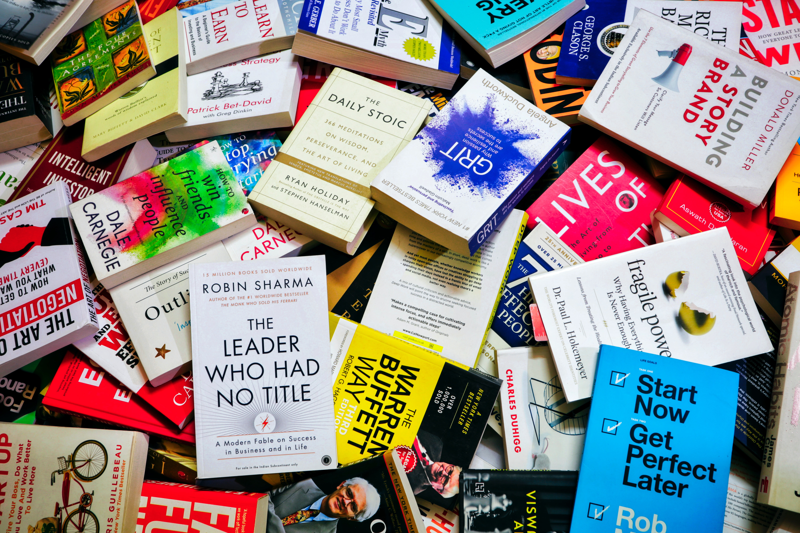
ECVET for Digital Publishing
03
MARKETING & DISTRIBUTION
INFLUENCER
ACTIONS
Social Media are the MAIN platform now regarding public relations and marketing.
An influencer has a huge community to talk to, so it is a very smart way to promote your e-book among the public.
Instagram is the main network used for this. Influencers can recommend the book through stories, a post on their feed, or sharing links to shop it online.
11

Slide 14
ECVET for Digital Publishing
MARKETING & DISTRIBUTION
Bookstagram
Bookstagrammers or even famous actors and personalities recommend books and e-books everyday as a paid action, for free or even with some kind of reward (getting the book for free if they recommend it online).
12

Slide 16
ECVET for Digital Publishing
04
MARKETING & DISTRIBUTION
ARTICLES
Newspaper or online media articles are long-form pieces of content authored by an expert that will be a source of credibility to your book.
These articles are beneficial for both a writer and an author because they give readers with valuable and safe information and the author will benefit from visits to their website or profile.
13

Slide 17
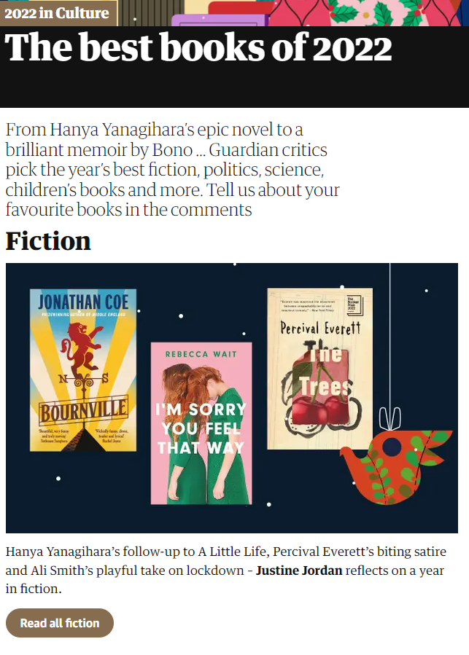
ECVET for Digital Publishing
MARKETING & DISTRIBUTION
The Guardian
Articles like this, in Online media as The Guardian talking about the best books in 2022 shows how important is PR still in the journalism sphere.
Be featured in an article like this can revenue to an e-book thousands of purchases.
14

Slide 18
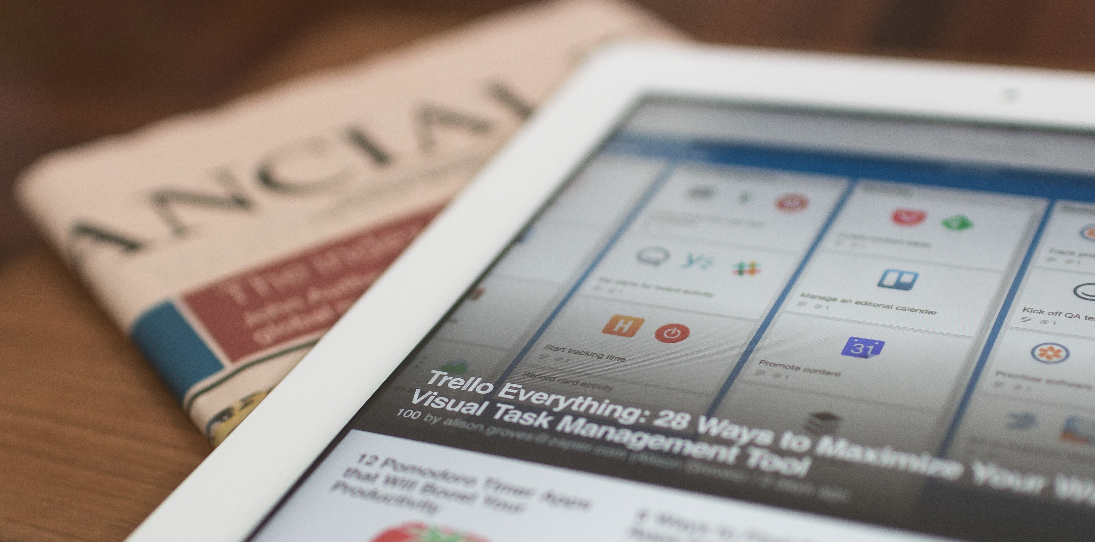

Slide 19
BENEFITS OF PUBLIC RELATIONS
ECVET for Digital Publishing
MARKETING & DISTRIBUTION
01
05
Improves SEO rankings
Builds Brand credibility
02
Generate leads
06
Get attention from investors
03
Increases website traffic
07
Generate social engagement
04
Grows sales
15

Slide 21
WHAT IS ONLINE PR?
Press play

Slide 22
THANK YOU

Slide 23
ECVET for Digital Publishing
Project participants:

