Slide 1
UNIT 5. ECVET DIGITAL PUBLISHING
UNIT 5 – MARKETING AND PUBLIC RELATIONS
Distribution in Digital Publishing

Slide 2
Contents
What is Distribution
Distribution process
Distribution partners

Slide 3
ECVET for Digital Publishing
MARKETING & PUBLIC RELATIONS
WHAT IS DISTRIBUTION
Book distribution gathers distribution of physical books (in site and online) and e-book distribution.
E-Book distribution is a very complex and evolving process that is always changing an counting with more and more players in the market. The business is growing and it is important to keep to date with new technologies, new options and customers demands.
Having a quality e-book is key, of course but you need more. You need very effective e-book distribution services that will enable you to reach your audience and growing your sales getting new customers and resources.
“E-book distribution is a complex and evolving process”
3

Slide 4
ECVET for Digital Publishing
MARKETING & PUBLIC RELATIONS
DISTRIBUTION PROCESS
As said before, in addition to print books, many authors also choose to publish e-book versions of their books or exclusively publish e-books.
Although paper books are still number one, e-book lovers continue to increase.
E-books are cheaper to produce, have a many distribution options, maintain good royalties comparing to print options and have more promotional opportunities.
4

Slide 5
DISTRIBUTION PROCESS OPTIONS
ECVET for Digital Publishing
MARKETING & PUBLIC RELATIONS
01
Own website
02
Distribution partners
03
Options of online distribution
5

Slide 6
ECVET for Digital Publishing
01
MARKETING & PUBLIC RELATIONS
OWN WEBSITE
One of the options to distribute online your e-book is creating your own website.
You can create a landing page that will guide your potential customer to your web when they can acquire the product.
These customers can come from blogs, social media links, video recommendations, articles, paid ads…
This way you will avoid to pay commissions to any external distributor. No matter if your are an author or publisher.
6

Slide 7
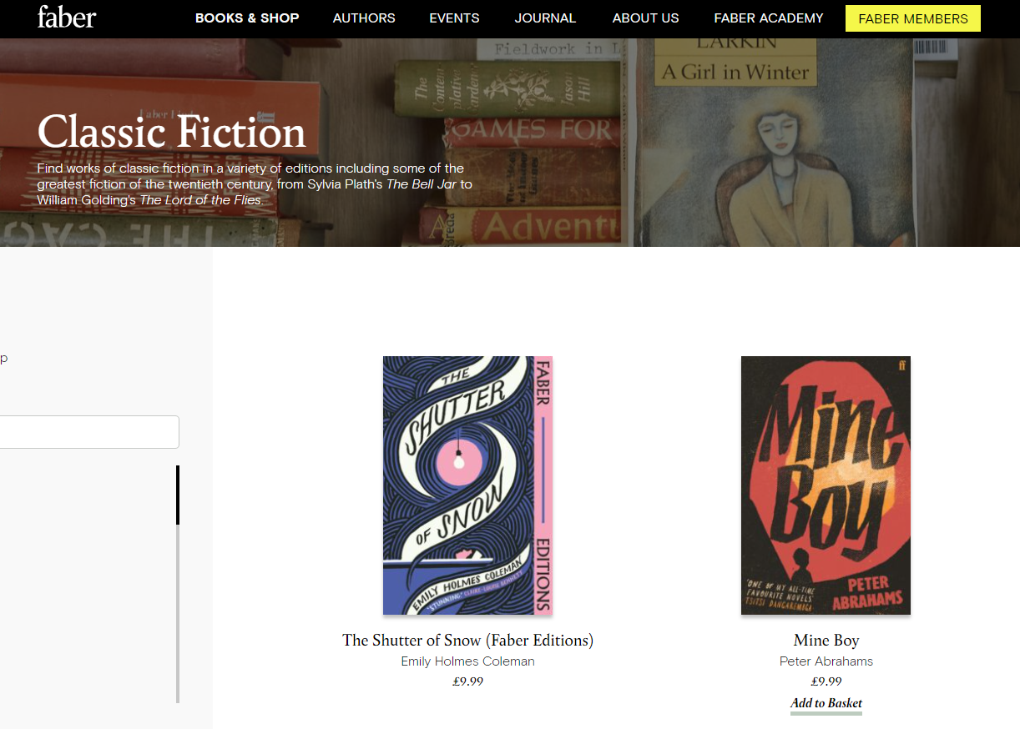
ECVET for Digital Publishing
MARKETING & PUBLIC RELATIONS
Editorial website
This is the website of Faber and Faber.
An editorial with its own website with all the information about authors, events and also an e-commerce part where you can shop online the books.
You can choose paperback or e-book option.
7

Slide 9
ECVET for Digital Publishing
02
MARKETING & PUBLIC RELATIONS
DISTRIBUTION
PARTNERS
Another option is working with distribution partners.
We have to have in mind that ,distribution partners reach more markets and readers in any country and around the world.
The following list shows just some examples of some of these distribution partners.
10

Slide 10
ECVET for Digital Publishing
MARKETING & PUBLIC RELATIONS
Distribution partners
Kindle Direct Publishing
Amazon
Kobo
Applebooks
11

Slide 11
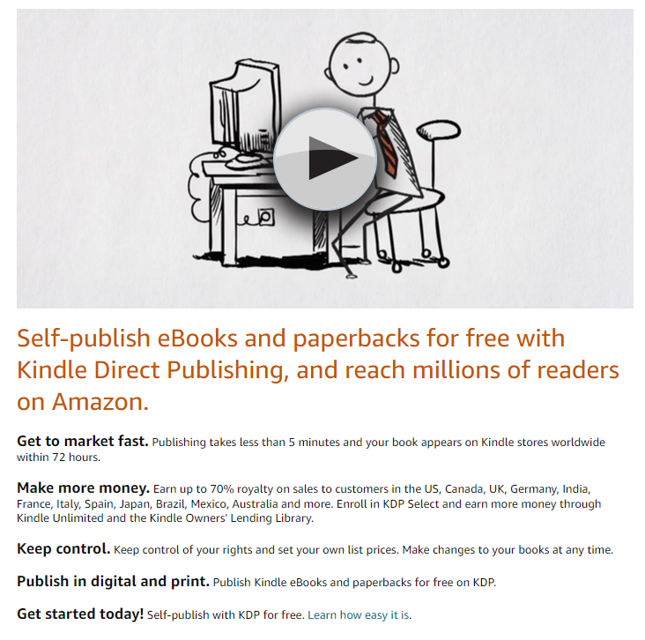
ECVET for Digital Publishing
MARKETING & PUBLIC RELATIONS
Kindle Direct Publishing
Kindle Direct Publishing, is one of the most popular e-book platforms.
It is the Amazon’s KDP Select Publishing program.
It will be your direct link to Amazon readers when you choose the Self publishing option
7

Slide 12
ECVET for Digital Publishing
MARKETING & PUBLIC RELATIONS
Amazon
Amazon is the biggest online retailer in the world and the Kindle option is for sure, the most popular e-reader on the market nowadays.
Your e-book will be available for sale and able to be read on the Kindle and other readers thanks to the Kindle reader app.
7

Slide 13
ECVET for Digital Publishing
MARKETING & PUBLIC RELATIONS
Kobo
Although Amazon is the number one, Kobo is also a very good option since it owns about 20% of the worldwide eBook market, and is the leading eBook retailer in some countries, including Canada and Japan.
7

Slide 14
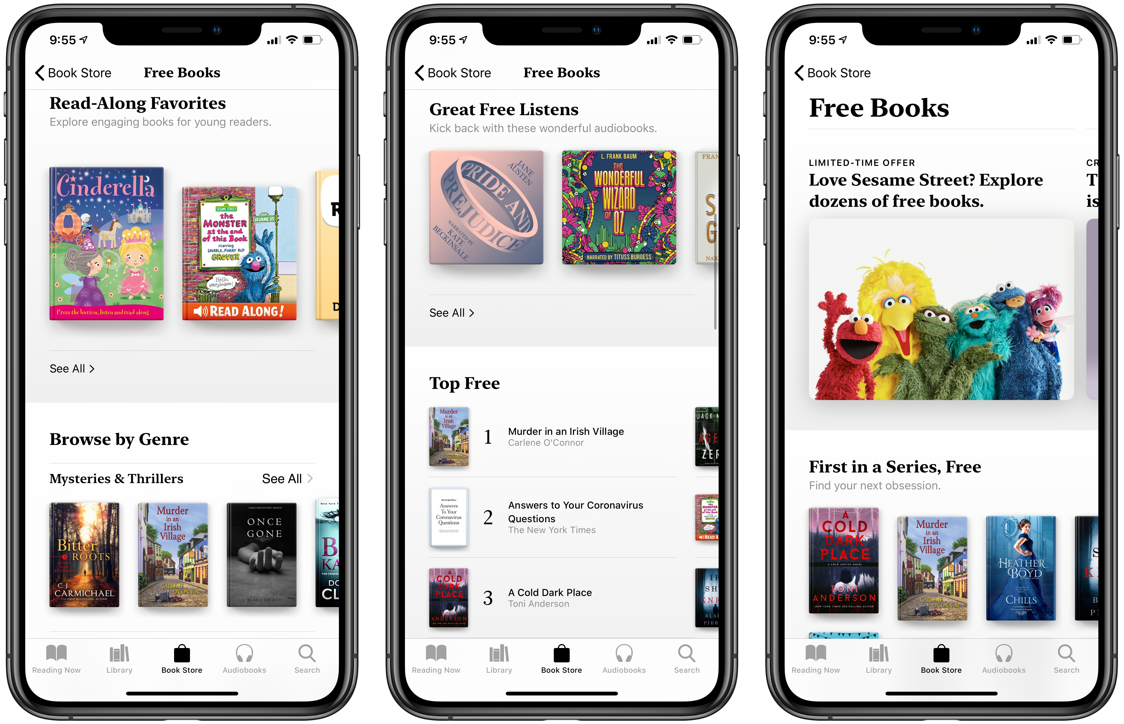
ECVET for Digital Publishing
MARKETING & PUBLIC RELATIONS
Applebooks
This is the distribution partner focused on apple users. It is a premier eBook destination for iPad, iPhone, and iTouch owners in over 50 countries around the world.
Of course maybe be taken into account that just focusing on apple users, you will be losing many readers.
7

Slide 16
ECVET for Digital Publishing
03
MARKETING & PUBLIC RELATIONS
OPTIONS OF ONLINE DISTRIBUTION
a
You can exclusively work with just one distributor. (May be your choice or an imposition of the platform)
b
You can distribute your e-book through several platforms. (Always when their rules alow you to do it)
c
You can distribute your e-book through platforms and also your own website.
10

Slide 18
E-BOOK DISTRIBUTION Tools, Aggregators, and Exclusivity vs. Going Wide
Press play

Slide 19
THANK YOU

Slide 20
ECVET for Digital Publishing
Project participants:

